Slide 1
DIGITAL ELECTRONICS COURSE: BTECH SEMESTER: 3RD BRANCH: CSE
Dr. SANTIMOY MANDAL
NSU, JAMSHEDPUR

Slide 2
Lecture of Module 1
Introduction to Digital Systems

Slide 3
Overview
▶ Introduction
▶ Digital and Analog Signals
▶ Logic Levels and Digital Waveforms
▶ Positive and Negative Logics
▶ Combinational and Sequential logics
▶ Types of Logic Devices

Slide 4
Introduction
Digital electronics is a field of electronics involving the study of digital signals and the engineering of devices that use or produce them.
This is in contrast to analog electronics and analog signals.
Digital electronic circuits are usually made from large assemblies of logic
gates, often packaged in integrated circuits.
Complex devices may have simple electronic representations of Boolean logic functions.

Slide 5
Analog versus Digital
▶ Most observables are analog
▶ But the most convenient way to represent and transmit information electronically is digital
▶ Analog/digital and digital/analog conversion is essential
Analog Signals: The analog signals were used in many systems to produce signals to carry information. These signals are continuous in both values and time.
In short, analog signals – all signals that are natural or come naturally are analog signals.
Digital Signals: Unlike analog signals, digital signals are not continuous but signals are discrete in value and time. These signals are represented by binary numbers and consist of different voltage values.

Slide 6
 | Difference Between Analog And Digital Signal
 | Analog Signals | Digital Signals
 | Continuous signals | Discrete signals
 | Represented by sine waves | Represented by square waves
 | Human voice, natural sound, analog electronic devices are few examples | Computers, optical drives, and other electronic devices
 | Continuous range of values | Discontinuous values
 | Records sound waves as they are | Converts into a binary waveform.
 | Only be used in analog devices. | Suited for digital electronics like computers, mobiles and more.

Slide 7
Signal Examples Over Time
Time
Continuous in value &
time
Analog
Digital
Asynchronous
Discrete in value
Synchronous

Slide 8
Digital Signal
▶ An information variable represented by physical quantity.
▶ For digital systems, the variable takes on discrete values.
▶ Two level, or binary values are the most prevalent values in digital systems.
▶ Binary values are represented abstractly by:
▶ digits 0 and 1
▶ words (symbols) False (F) and True (T)
▶ words (symbols) Low (L) and High (H)
▶ and words On and Off.
▶ Binary values are represented by values or ranges of values of physical quantities

Slide 9
Binary Values: Other Physical Quantities
▶ What are other physical quantities represent 0 and 1?
▶ CPU: Voltage Levels
▶ Disk: Magnetic Field Direction
▶ CD: Surface Pits/Light
▶ Dynamic RAM: Electrical charge

Slide 10
Digital System
Takes a set of discrete information inputs and discrete internal information (system state) and
generates a set of discrete information outputs.
Discrete Information Processing System
Discrete Inputs
Discrete Outputs
System State

Slide 11
Digital representations of logical functions
▶ Digital signals offer an effective way to execute logic. The formalism for performing logic with binary variables is called switching algebra or Boolean algebra.
▶ Digital electronics combines two important properties:
▶ The ability to represent real functions by coding the information in digital form.
▶ The ability to control a system by a process of manipulation and evaluation of digital variables using switching algebra.
▶ Digital signals can be transmitted, received, amplified, and retransmitted with no degradation.
▶ Binary numbers are a natural method of expressing logic variables.
▶ Complex logic functions are easily expressed as binary function.
▶ Digital information is easily and inexpensively stored

Slide 12
Logic Levels
In digital circuits, a logic level is one of a finite number of states that a digital signal can inhabit. Logic levels are usually represented by the voltage difference between the signal and ground, although other standards exist. The range of voltage levels that represent each state depends on the logic family being used.
In binary logic the two levels are logical high and logical low, which generally correspond to binary numbers 1 and 0 respectively. Signals with one of these two levels can be used in Boolean algebra for digital circuit design or analysis.
OUTPUT INPUT
5.0
4.0
3.0
2.0
1.0
0.0
Logic level | Active-high signal | Active-low signal
Logical high | 1 | 0
Logical low | 0 | 1
HIGH
HIGH
LOW
LOW
Volts

Slide 13
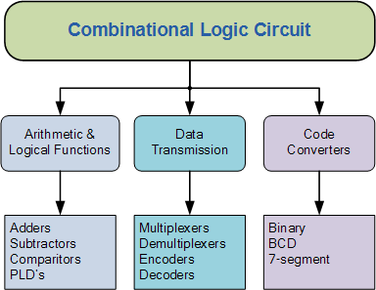
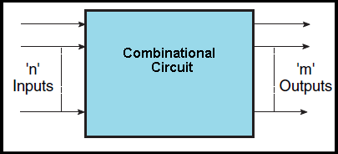
Combinational Logic Circuit
The outputs of Combinational Logic Circuits are only determined by the logical function of their current input state, logic “0” or logic “1”, at any given instant in time.

Slide 14
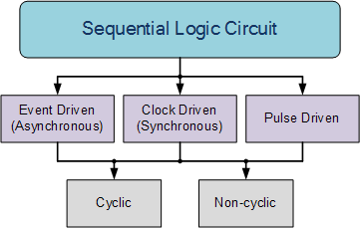
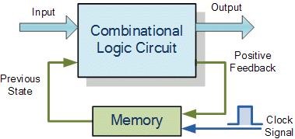
Sequential Logic Circuits
the output state of a “sequential logic circuit” is a function of the following three states, the “present input”, the “past input” and/or the “past output”. Sequential Logic circuits remember these conditions and stay fixed in their current state until the next clock signal changes one of the states, giving sequential logic circuits “Memory”.
Sequential logic circuits are generally termed as two state or Bistable devices which can have their output or outputs set in one of two basic states, a logic level “1” or a logic level “0” and will remain “latched” (hence the name latch) indefinitely in this current state or condition until some other input trigger pulse or signal is applied which will cause the bistable to change its state once again.

Slide 15
Fixed function Logic devices
Fixed logic device such as a logic gate or a multiplexer or a flip-flop performs a given logic function that is known at the time of device manufacture
Complexity Classification for Fixed-Function ICs
SSI (Small-scale integration) – 10 gates–
MSI (Medium-scale integration) – 10—100 gates LSI (Large-scale integration) – 100—10,000 gates
VLSI (Very large-scale integration) – 10,000—100,000 gates
ULSI (Ultra large-scale integration) -- >100,000 gates

Slide 16
Programmable Logic Devices
A programmable logic device can be configured by the user to perform a large variety of logic functions
A programmable logic device (PLD) is an electronic component used to build reconfigurable digital circuits PLD has an undefined function at the time of manufacture
Before using PLD in a circuit it must be programmed (reconfigured) by using a specialized program
Purpose of PLD:
▶ Permits elaborate digital logic designs to be implemented by the user on a single device.
▶ Is capable of being erased and reprogrammed with a new design.

Slide 17
Advantages of PLDs
▶ Programmability
▶ Re-programmability
▶ PLDs can be reprogrammed without being removed from the circuit board.
▶ Low cost of design
▶ Immediate hardware implementation
▶ less board space
▶ lower power requirements (i.e., smaller power supplies)
▶ Faster assembly processes
▶ higher reliability (fewer ICs and circuit connections => easier troubleshooting)
▶ availability of design software

Slide 18
Types of PLDs
▶ SPLDs (Simple Programmable Logic Devices)
▶ ROM (Read-Only Memory)
▶ PLA (Programmable Logic Array)
▶ PAL (Programmable Array Logic)
▶ GAL (Generic Array Logic)
▶ HCPLD (High Capacity Programmable Logic Device)
▶ CPLD (Complex Programmable Logic Device)
▶ FPGA (Field-Programmable Gate Array)
PLD
SPLD
HCPLD
ROM
PLA
PAL
GAL
CPLD
FPGA

Slide 19
PLD Configuration
▶ Combination of a logic device and memory
▶ Memory stores the pattern the PLD was programmed with
▶ EPROM
▶ Non-volatile and reprogrammable
▶ EEPROM
▶ Non-volatile and reprogrammable
▶ Static RAM (SRAM)
▶ Volatile memory
▶ Flash memory
▶ Non-volatile memory
▶ Antifuse
▶ Non-volatile and no re-programmability

Slide 20
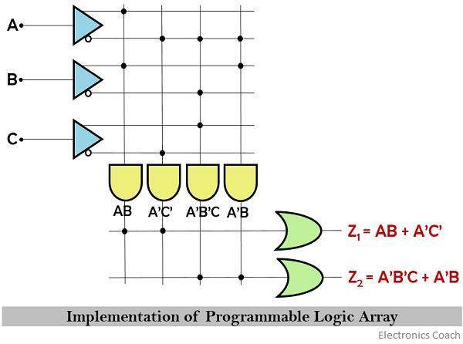
PLA
PLA: A programmable logic array (PLA) has a programmable AND gate array, which links to a programmable OR gate array

Slide 21
PAL
PAL: PAL devices have arrays of transistor cells arranged in a "fixed-OR, programmable- AND" plane

Slide 22
GAL
GAL: An improvement on the PAL was the Generic Array Logic device
This device has the same logical properties as the PAL but can be erased and reprogrammed
The GAL is very useful in the prototyping stage of a design, when any bugs in the logic can be corrected by reprogramming
GALs are programmed and reprogrammed using a PAL programmer

Slide 23
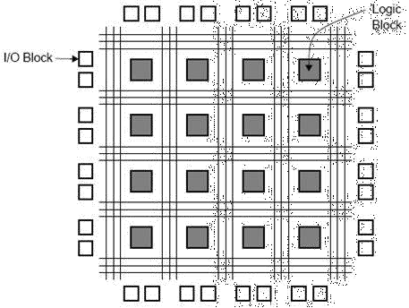
HCPLD
▶ CPLD (Complex Programmable Logic Device)
▶ Lies between PALs and FPGAs in degree of complexity.
▶ Inexpensive
▶ FPGA (Field-Programmable Gate Array)
▶ Truly parallel design and operation
▶ Fast turnaround design
▶ Array of logic cells surrounded by programmable I/O blocks
FPGA

Slide 24
Number Systems

Slide 25
Overview
▶ Introduction
▶ Number Systems [binary, octal and hexadecimal]
▶ Number System conversions

Slide 26
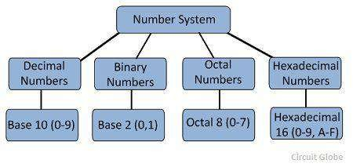
Introduction
Number System
Code using symbols that refer to a number of items
Decimal Number System
Uses ten symbols (base 10 system)
Binary System
Uses two symbols (base 2 system)
Octal Number System
Uses eight symbols (base 8 system)
Hexadecimal Number System
Uses sixteen symbols (base 16 system)

Slide 27
Binary Number
Numeric value of symbols in different positions.
Example - Place value in binary system:
Place Value 8s 4s
2s
1s
Binary
Yes
Yes
No
No
Number 1 1 0
RESULT: Binary 1100 = decimal 8 + 4 + 0 + 0 = decimal 12
0

Slide 28
BINARY TO DECIMAL CONVERSION
Convert Binary Number 110011 to a Decimal Number:
Binary
1 1 0 0 1 1
Decimal
32 + 16 + 0 + 0 +
2 + 1 = 51

Slide 29
TEST
Convert the following binary numbers into decimal numbers:
Binary | 1001 | =
Binary | 1111 | =
Binary | 0010 | =

Slide 30
TEST
Convert the following binary numbers into decimal numbers:
9
15
2
Binary | 1001 | =
Binary | 1111 | =
Binary | 0010 | =

Slide 31
DECIMAL TO BINARY CONVERSION
Divide by 2 Process
Decimal #
13 ÷ 2 = 6
remainder 1
6 ÷ 2 = 3 remainder 0
3 ÷ 2 = 1 remainder 1
1 ÷ 2 = 0 remainder 1
1 1 0 1

Slide 32
TEST
Convert the following decimal numbers into binary:
Decimal 11 =
Decimal 4 =
Decimal 17 =

Slide 33
TEST
Convert the following decimal numbers into binary:
Decimal 11 =
Decimal 4 =
Decimal 17 =
1011
0100
10001

Slide 36
HEXADECIMAL NUMBER SYSTEM
Uses 16 symbols -Base 16 System, 0-9, A, B, C, D, E, F
Decimal
0
1
2
3
4
5
6
7
8
9
10
11
12
13
14
15
16
Binary
0000
0001
0010
0011
0100
0101
0110
0111
1000
1001
1010
1011
1100
1101
1110
1111
0001 0000
Hexadecimal
0
1
2
3
4
5
6
7
8
9
A B C D E F 10

Slide 37
HEXADECIMAL AND BINARY CONVERSIONS
Hexadecimal to Binary Conversion
Hexadecimal C 3
Binary 1100 0011
Binary to Hexadecimal Conversion
Binary 1110 1010
Hexadecimal E A

Slide 38
DECIMAL TO HEXADECIMAL CONVERSION
Divide by 16 Process
Decimal #
47 ÷ 16 = 2
remainder 15
2 ÷ 16 = 0 remainder 2
2 F

Slide 40
HEXADECIMAL TO DECIMAL CONVERSION
Convert hexadecimal number 2DB to a decimal number
Place Value
256s
16s
1s
Hexadecimal
2
D
B
(256 x 2)
(16 x 13)
(1 x 11)
Decimal
512 +
208
+ 11 =
731

Slide 42
TEST
Convert Hexadecimal number A6 to Binary
A6 =
1010 0110
(Binary)
▶ Translate every hexadecimal digit into its 4-bit binary equivalent
▶ Examples:
Convert Hexadecimal number 16 to Decimal
(3A5)₁₆
(12.3D)₁₆
(1.8)₁₆
= (0011 1010 0101)₂
= (0001 0010 . 0011 1101)₂
= (0001 . 1000)₂
16 =
22
(Decimal)
Convert Decimal 63 to Hexadecimal
63 =
3F
(Hexadecimal)

Slide 43
OCTAL NUMBERS
Uses 8 symbols -Base 8 System
0, 1, 2, 3, 4, 5, 6, 7
Decimal
0
1
2
3
4
5
6
7
8
9
Binary 000
001
010
011
100
101
110
111
001 000
001 001
Octal 0
1
2
3
4
5
6
7
10
11

Slide 44
OCTAL AND BINARY CONVERSIONS
Octal to Binary Conversion
Octal
5
6
Binary 101 110
Binary to Octal Conversion
Binary | 100 | 101
Octal | 4 | 5

Slide 45
DECIMAL TO OCTAL CONVERSION
Divide by 8 Process
Decimal #
129 ÷ 8 = 16 remainder 1
16 ÷ 8 = 2 remainder 0
2 ÷ 8 = 0 remainder 2
2 0 1

Slide 47
OCTAL TO DECIMAL CONVERSION
Convert octal number 201to a decimal number
Place Value
64s
8s
1s
Octal
2
0
1
(64 x 2)
(8 x 0) (1 x 1)
0 + 1 =
Decimal
128 +
129

Slide 49
Convert 0.10111₂ to base 8: 0.101_110 = 0.56₈
Convert 0.1110101 to base 16: 0.1110_1010 = 0.EA₁₆

Slide 50
Arithmetic Operations

Slide 51
Overview
▶ Arithmetic Operations
▶ Decimal Arithmetic
▶ Binary Arithmetic
▶ Signed Binary Numbers

Slide 52
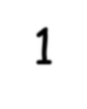
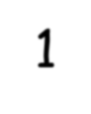
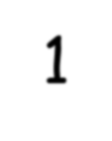
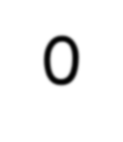
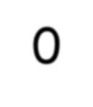
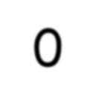
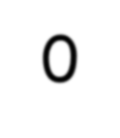
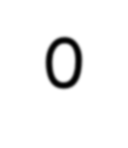
Arithmetic Operations
Addition
▶ Follow same rules as in decimal addition, with the difference that when sum is 2 indicates a carry (not a 10)
▶ Learn new carry rules
▶ 0+0 = sum 0 carry 0
▶ 0+1 = 1+0 = sum 1carry 0
▶ 1+1 = sum 0 carry1
▶ 1+1+1 = sum 1carry1
Carry | 1 | 1 | 1 | 1 | 1 | 0
Augend | 0 | 0 | 1 | 0 | 0 | 1
Addend | 0 | 1 | 1 | 1 | 1 | 1
Result | 1 | 0 | 1 | 0 | 0 | 0
1 1 1
0 1 0 1
+ 1 0 1 1
1 0 0 0 0
Carry Values

Slide 53
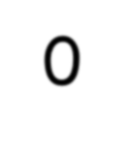
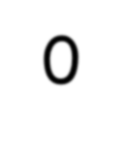
Subtraction
▶ Learn new borrow rules
▶ 0-0 = 1-1 = 0 borrow 0
▶ 1-0 = 1 borrow 0
▶ 0-1 = 1 borrow 1
The rules of the decimal base applies to binary as well. To be able to calculate 0-1, we have to “borrow one” from the next left digit.
Borrow | 1 | 1 | 0 | 0
Minuend | 1 | 1 | 0 | 1 | 1
Subtrahend | 0 | 1 | 1 | 0 | 1
Result | 0 | 1 | 1 | 1 | 0
1 2
0 2 0 2
1 0 1 0
- 0 1 1 1
0 0 1 1

Slide 54
Decimal Subtraction
▶ 9’s Complement Method
▶ 10’s Complement Method
7 2 5 3 2
+ 9 6 7 4 9
1 6 9 2 8 1
+1 6 9 2 8 2
9’s Complement Method
Example: 72532 – 3250
9’s complement of 3250 is
9 9 9 9 9 – 0 3 2 5 0 = 9 6 7 4 9
If Carry, result is positive.
Add carry to the partial result
Example: 3250 – 72532
9’s complement of 72532 is
9 9 9 9 9 – 7 2 5 3 2 = 2 7 4 6 7
0 3 2 5 0
+ 2 7 4 6 7
If no Carry, result is negative.
Magnitude is 9’s complement of the result
3 0 7 1 7
= – 6 9 2 8 2

Slide 55
Decimal Subtraction
▶ 9’s Complement Method
▶ 10’s Complement Method
7 2 5 3 2
10’s Complement Method
+ 9 6 7 5 0
Example: 72532 – 3250
10’s complement of 3250 is
1 0 0 0 0 0 – 0 3 2 5 0 = 9 6 7 5 0
1 6 9 2 8 2
Result is 6 9 2 8 2
If Carry, result is positive.
Discard the carry
Example: 3250 – 72532
10’s complement of 72532 is
1 0 0 0 0 0 – 7 2 5 3 2 = 2 7 4 6 8
0 3 2 5 0
+ 2 7 4 6 8
If no Carry, result is negative.
Magnitude is 10’s complement of the result
3 0 7 1 8
= – 6 9 2 8 2

Slide 56
Binary Subtraction
▶ 1’s Complement Method
▶ 2’s Complement Method
1 0 1 0 1 0 0
+ 0 1 1 1 0 1 1
1 0 0 0 1 1 1 1
+1 0 0 1 0 0 0 0
1’s Complement Method
Example: 1010100 – 1000100
1’s complement of 1000100 is 0111011
If Carry, result is positive.
Add carry to the partial result
Example: 1000100 – 1010100
1 0 0 0 1 0 0
+ 0 1 0 1 0 1 1
1’s complement of 1010100 is 0101011
If no Carry, result is negative.
Magnitude is 1’s complement of the result
1 1 0 1 1 1 1
= – 0 0 1 0 0 0 0

Slide 57
Binary Subtraction
▶ 1’s Complement Method
▶ 2’s Complement Method
1 0 1 0 1 0 0
+ 0 1 1 1 1 0 0
1 0 0 1 0 0 0 0
2’s Complement Method
Example: 1010100 – 1000100
2’s complement of 1000100 is 0111100
If Carry, result is positive.
Discard the carry
0 0 1 0 0 0 0
Example: 1000100 – 1010100
1 0 0 0 1 0 0
+ 0 1 0 1 1 0 0
2’s complement of 1010100 is 0101100
If no Carry, result is negative.
Magnitude is 2’s complement of the result
1 1 1 0 0 0 0
= – 0 0 1 0 0 0 0

Slide 58
Signed Binary Numbers
▶ When a signed binary number is positive
The MSB is ‘0’ which is the sign bit and rest bits represents the magnitude
▶ When a signed binary number is negative
The MSB is ‘1’ which is the sign bit and rest of the bits may be represented
by three different ways
Signed magnitude representation
Signed 1’s complement representation
Signed 2’s complement representation

Slide 59
Signed Binary Numbers
- 9
1 1001
1 0110
1 0111
- 0
1 0000
1 1111
-None-
+ 9
0 1001
0 1001
0 1001
+ 0
0 0000
0 0000
0 0000
Signed magnitude representation Signed 1’s complement representation Signed 2’s complement representation
Signed magnitude representation Signed 1’s complement representation Signed 2’s complement representation

Slide 60
Range of Binary Number
Binary Number of n bits
▶ General binary number: ( )
▶ Signed magnitude binary number: – (
) to + (
)
▶ Signed 1’s complement binary number: – (
) to + (
)
▶ Signed 2’s complement binary number: – (
) to + (
)

Slide 61
Signed Binary Number Arithmetic
▶ Add or Subtract two signed binary number including its sign bit either signed 1’s complement method or signed 2’s complement method
▶ The 1’s complement and 2’s complement rules of general binary number is applicable
to this
It is important to decide how many bits we will use to represent the number
Example: Representing +5 and -5 on 8 bits:
– +5: 00000101
– -5: 10000101
So the very first step we have to decide on the number of bits to represent number

Slide 62
Digital Codes

Slide 63
Overview
▶ Introduction
▶ Binary Coded Decimal Code
▶ EBCDIC Code
▶ Excess-3 Code
▶ Gray Code
▶ ASCII Code

Slide 64
Introduction
▶ Calculations or computations are not useful until their results can be displayed in a manner that is meaningful to people.
▶ We also need to store the results of calculations, and provide a means for data input.
▶ Thus, human-understandable characters must be converted to computer-
understandable bit patterns using some sort of character encoding scheme.
▶ As computers have evolved, character codes have evolved.
▶ Larger computer memories and storage devices permit richer character codes.
▶ The earliest computer coding systems used six bits.
▶ Binary-coded decimal (BCD) was one of these early codes. It was used by IBM mainframes in the 1950s and 1960s.

Slide 65
▶ In 1964, BCD was extended to an 8-bit code, Extended Binary-Coded Decimal Interchange Code (EBCDIC).
▶ EBCDIC was one of the first widely-used computer codes that supported upper and lowercase alphabetic characters, in addition to special characters, such as punctuation and control characters.
▶ EBCDIC and BCD are still in use by IBM mainframes today.
▶ Other computer manufacturers chose the 7-bit ASCII (American Standard Code for
Information Interchange) as a replacement for 6-bit BCD codes.
▶ While BCD and EBCDIC were based upon punched card codes, ASCII was based upon telecommunications (Telex) codes.
▶ Until recently, ASCII was the dominant character code outside the IBM mainframe world.

Slide 66
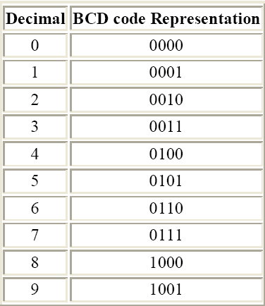
Binary Coded Decimal (BCD)

Slide 67
▶ Consider 5 + 5
5 0 1 0 1
+5 0 1 0 1
1 0 1 0 which is binary 10
▶
▶ Had 1010 and want to add 6 or 0110
▶
▶ so 1 0 1 0
▶ plus 6 0 1 1 0
▶ giving
but not a BCD digit!
▶ What to do?
▶ Try adding 6??
▶ Giving 1 0 0 0 0

Slide 68
▶ Add 7 + 6
▶ have 7
▶ plus 6
▶ Giving of range
0 1 1 1
0 1 1 0
1 1 0 1 and again out
▶ Adding 6 0 1 1 0
▶ Giving 1 0 0 1 1 so a 1 carries out to the next BCD digit
▶ FINAL BCD answer 0001 0011
or 13₁₀

Slide 69
▶ Add the BCD for 417 to 195
▶ Would expect to get 612
▶ BCD setup - start with Least Significant Digit
▶ Had a carry to the 2nd BCD digit position
▶ |  | 1
▶ | 0 1 0 0 | 0 0 0 1 | done
▶ | 0 0 0 1 | 1 0 0 1 | 0 0 1 0
▶ |  | 1 0 1 1
▶ | Again must add 6 | 0 1 1 0
▶ | Giving 1 | 0 0 0 1
▶ 0 1 0 0 | 0 0 0 1 | 0 1 1 1
▶ 0 0 0 1 | 1 0 0 1 | 0 1 0 1
▶ |  | 1 1 0 0
▶ Adding 6 |  | 0 1 1 0
▶ Gives | 1 | 0 0 1 0
▶ And another carry

Slide 70
▶ Had a carry to the 3rd BCD digit position
▶
1
▶ 0 1 0 0
▶ 0 0 0 1
▶ 0 1 1 0
done done 0 0 0 1 0 0 1 0
▶ And answer is 0110 0001 0010 or the BCD for the base 10 number 612

Slide 71
EBCDIC Code
▶ The EBCDIC code is an 8-bit alphanumeric code that was developed by IBM to represent alphabets, decimal digits and special characters, including control characters.
▶ The EBCDIC codes are generally the decimal and the hexadecimal representation of different characters.
▶ This code is rarely used by non IBM-compatible computer systems.

Slide 72
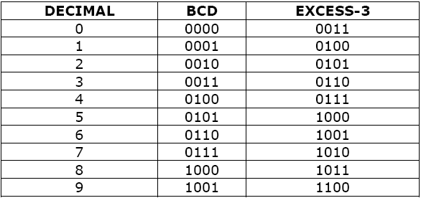
The Excess-3- Code
▶ Excess-3 code is self complementary code? Justify.

Slide 73
Gray Code
▶ Gray code is another important code that is also used to convert the decimal number into 8-bit binary sequence. However, this conversion is carried in a manner that the contiguous digits of the decimal number differ from each other by one bit only
▶ In pure binary coding or 8421 BCD then counting from 7 (0111) to 8 (1000)
requires 4 bits to be changed simultaneously
▶ Gray coding avoids this since only one bit changes between subsequent numbers

Slide 74
Binary to Gray
Example:
Binary:
b₅ b₄ b₃ b₂ b₁ b₀
1 0 1 1 0 1
g₅ = b₅
g₄ = b₅ Ꚛ b₄ g₃ = b₄ Ꚛ b₃ g₂ = b₃ Ꚛ b₂
g₁ = b₂ Ꚛ b₁ g₀ = b₁ Ꚛ b₀
+ + + + + +
1 1 1 0 1 1
g₅ g₄ g₃ g₂ g₁ g₀
Gray:

Slide 75
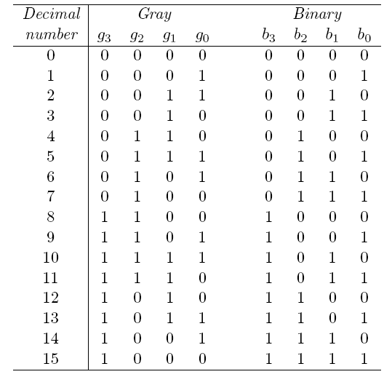
Gray to Binary
b₅ = g₅
b₄ = g₅ Ꚛ g₄
b₃ = g₅ Ꚛ g₄ Ꚛ g₃
b₂ = g₅ Ꚛ g₄ Ꚛ g₃ Ꚛ g₂
b₁ = g₅ Ꚛ g₄ Ꚛ g₃ Ꚛ g₂ Ꚛ g₁
b₀ = g₅ Ꚛ g₄ Ꚛ g₃ Ꚛ g₂ Ꚛ g₁ Ꚛ g₀

Slide 76
Reflection of Gray Codes
00
01
11
0 00
0 01
0 11
0 000
0 001
0 011
0 010
0 110
0 111
0 101
10 0 10
1 10
1 11
1 01
1 00 0 100
1 100
1 101
1 111
1 110
1 010
1 011
1 001
1 000
So, called reflected code

Slide 77
Alphanumeric Codes
▶ How do you handle alphanumeric data?
▶ Easy answer!
▶ Formulate a binary code to represent characters! ☺
▶ For the 26 letter of the alphabet would need 5 bit for representation.
▶ But what about the upper case and lower case, and the digits, and
special characters

Slide 78
ASCII
▶ ASCII stands for American Standard Code for Information Interchange
▶ The code uses 7 bits to encode 128 unique characters
▶ Formally, work to create this code began in 1960. 1st standard in 1963. Last updated in 1986
▶ Represents the numbers
▶ All start 011 xxxx and the xxxx is the BCD for the digit
▶ Represent the characters of the alphabet
▶ Start with either 100, 101, 110, or 111
▶ A few special characters are in this area
▶ Start with 010 – space and !”#$%&’()*+.-,/
▶ Start with 000 or 001 – control char like ESC

Slide 79
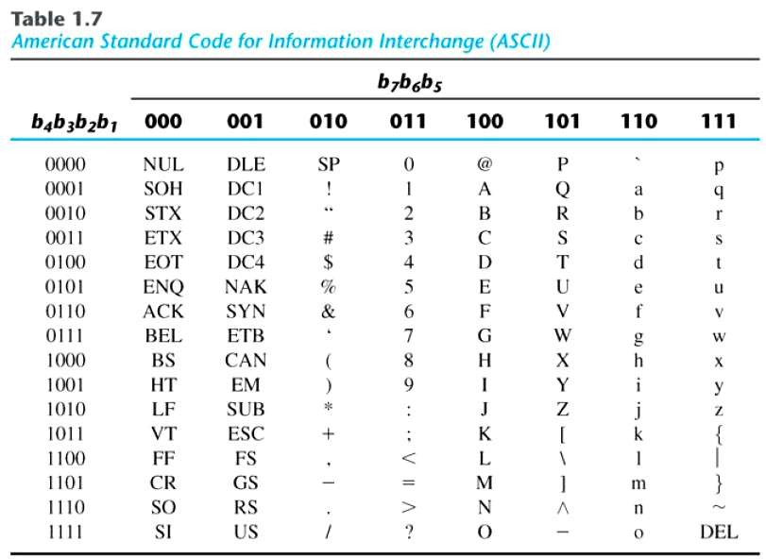
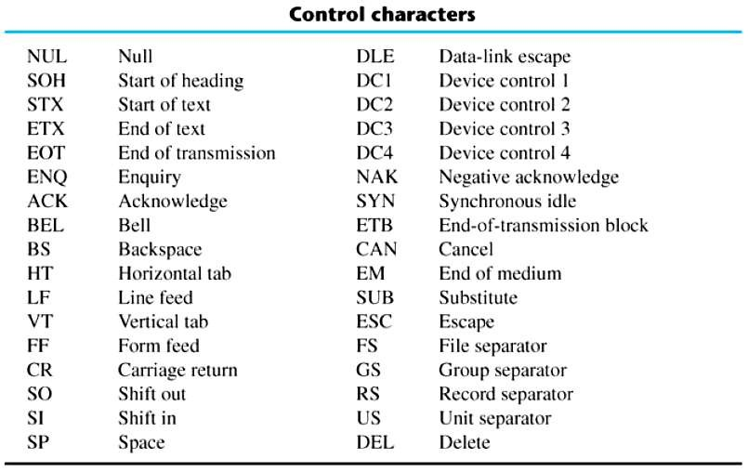

Slide 80
ASCII Properties
ASCII has some interesting properties:
Digits 0 to 9 span Hexadecimal values 30₁₆ to 39₁₆
Upper case A - Z span 41₁₆ to 5A₁₆
Lower case a - z span 61₁₆ to 7A₁₆
Lower to upper case translation (and vice versa) occurs by flipping bit 6.
Delete (DEL) is all bits set, a carryover from when punched paper tape was used to store messages.
Punching all holes in a row erased a mistake!

Slide 81
Lecture of Module 2
Logic Gates

Slide 82
Overview
▶ Introduction
▶ Logical Operators
▶ Basic Gates
▶ Universal Gates
▶ Realization of Basic Gates using Universal Gates
▶ Other Logic Gates

Slide 83
Introduction
▶Binary variables take on one of two values
▶Logical operators operate on binary values and binary variables
▶Basic logical operators are the logic functions AND, OR and NOT
▶Logic gates implement logic functions
▶Boolean Algebra: a useful mathematical system for specifying and
transforming logic functions
▶We study Boolean algebra as a foundation for designing and analyzing digital systems

Slide 84
Binary Variables
▶ Recall that the two binary values have different names:
▶ True/False
▶ On/Off
▶ Yes/No
▶ 1/0
▶ We use 1 and 0 to denote the two values.
▶ Variable identifier examples:
▶ A, B, x, y, z, or X₁ , X₂ etc. for now

Slide 85
Logical Operations
▶ The three basic logical operations are:
▶ AND
▶ OR
▶ NOT
▶ AND is denoted by a dot (·)
▶ OR is denoted by a plus (+)
▶ NOT is denoted by an over bar ( ¯ ), a single quote mark (') after, or (~) before
the variable

Slide 86
Operator
Operators operate on binary values and binary variables
Operations are defined on the values "0" and "1" for each operator:
AND
0 · 0 = 0
0 · 1 = 0
1 · 0 = 0
1 · 1 = 1
OR
0 + 0 = 0
0 + 1 = 1
1 + 0 = 1
1 + 1 = 1
NOT
0 = 1
1 = 0

Slide 87
Truth Tables
▶ Truth table - a tabular listing of the values of a function for all possible combinations of values on its arguments
▶ Example: Truth tables for the basic logic operations:
AND
X | Y | Z = X·Y
0 | 0 | 0
0 | 1 | 0
1 | 0 | 0
1 | 1 | 1
OR
X | Y | Z = X+Y
0 | 0 | 0
0 | 1 | 1
1 | 0 | 1
1 | 1 | 1
NOT
X | Z = X̅
0 | 1
1 | 0

Slide 88
Logic Function Implementation
Switches in parallel => OR
▶ Using Switches
▶ For inputs:
▶ logic 1 is switch closed
▶ logic 0 is switch open
▶ For outputs:
▶ logic 1 is light on
▶ logic 0 is light off.
Switches in series => AND

Slide 89
Logic Gates
▶ In the earliest computers, switches were opened and closed by magnetic fields produced by energizing coils in relays. The switches in turn opened and closed the current paths.
▶ Later, vacuum tubes that open and close current paths electronically replaced relays.
▶ Today, transistors are used as electronic switches that open and close current paths.
▶ NOT, AND and OR Gates (Basic gates)
▶ NAND and NOR Gates (Universal logic gates)

Slide 90
NOT Gate
A NOT gate accepts one input signal (0 or 1) and returns the opposite signal as output

Slide 91
AND Gate
If all inputs are 1, the output is 1; otherwise, the output is 0 Or if any input is 0, output is 0

Slide 92
OR Gate
If all inputs are 0, the output is 0; otherwise, the output is 1 Or if any input is 1, output will be 1

Slide 93
Universal Gates
Universal Logic Gate: Any basic gate or logic function can be realized using this gate
Two universal logic gates
NAND
NOR

Slide 94
NAND Gate
If all inputs are 1, the output is 0; otherwise, the output is 1

Slide 95
NOR Gate
If all inputs are 0, the output is 1; otherwise, the output is 0

Slide 96
Realization
NAND gates are sometimes called universal gates because they can be used to
produce the other basic Boolean functions.
A
A
A B
AB
Inverter
AND gate
A
A
A + B
A + B
B
B
OR gate
NOR gate

Slide 97
Realization
NOR gates are also universal gates and can form all of the basic gates.
A
A
A B
A + B
Inverter
OR gate
A
A
AB
AB
B
B
AND gate
NAND gate

Slide 98
XOR Gate
If odd numbers of inputs are 1, the output is 1; otherwise, the output is 0

Slide 99
X-NOR Gate
XNOR
X | Y | Z
0 | 0 | 1
0 | 1 | 0
1 | 0 | 0
1 | 1 | 1
X Y
Z

Slide 100
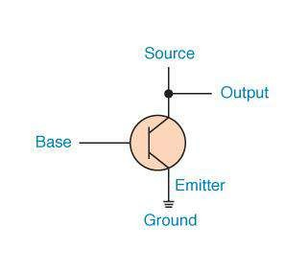
Constructing Gates
Transistor
A device that acts either as a wire that conducts electricity or as a resistor that blocks the
flow of electricity, depending on the voltage level of an input signal
A transistor has no moving parts, yet acts like a switch
It is made of a semiconductor material, which is neither a particularly good conductor of electricity nor a particularly good insulator
A transistor has three terminals
A source A base
An emitter, typically connected to a ground wire
If the electrical signal is grounded, it is allowed to flow through an alternative route to the ground (literally) where it can do no harm

Slide 101
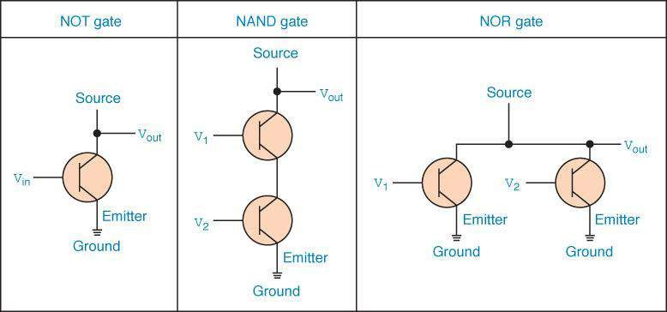

Slide 102
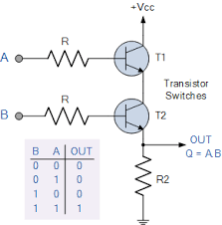
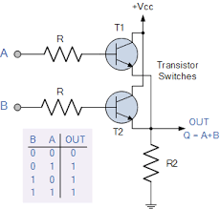
AND Gate
OR Gate

Slide 103
Timing Diagram
t₀ t₁ t₂ t₃ t₄ t₅ t₆
1
A B
Input signals
0
1
0
Transitions
F=A•B
G=A+B
H=A’
1
0
Basic Assumption: Zero time for signals to propagate Through gates
Gate Output Signals
1
0
1
0

Slide 104
Gate Delay
▶ In actual physical gates, if one or more input changes causes the output to change, the output change does not occur instantaneously.
▶ The delay between an input change(s) and the resulting output change is the gate delay
denoted by t_{G}:
1
0
1
0
Input
tG = 0.3 ns
tG
tG
Output
0
0.5
1
1.5
Time (ns)

Slide 105
Boolean Algebra

Slide 106
Overview
▶ Introduction
▶ Boolean Algebra
▶ Properties
▶ Algebraic Manipulation
▶ De-Morgan Theorem
▶ Complementation
▶ Truth Table

Slide 107
Introduction
▶ Understand the relationship between Boolean logic and digital computer circuits.
▶ Learn how to design simple logic circuits.
▶ Understand how digital circuits work together to form complex computer systems.
▶ In the latter part of the nineteenth century, George Boole suggested that logical thought could be represented through mathematical equations.
▶ Computers, as we know them today, are implementations of Boole’s Laws of Thought.
▶ In this chapter, you will learn the simplicity that constitutes the essence of the machine (Boolean Algebra).

Slide 108
Boolean algebra
▶ Boolean algebra is a mathematical system for the manipulation of variables that can have one of two values.
▶ In formal logic, these values are “true” and “false.”
▶ In digital systems, these values are “on” and “off,” 1 and 0, or “high”
and “low.”
▶ Boolean expressions are created by performing operations on Boolean variables.
▶ Common Boolean operators include AND, OR, NOT, XOR, NAND and NOR

Slide 109
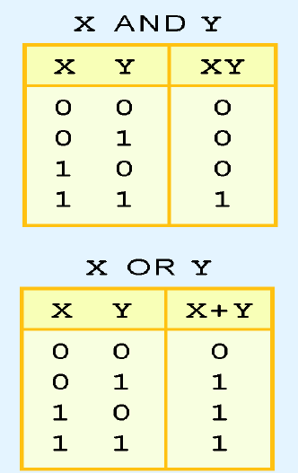
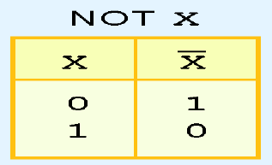
▶ A Boolean operator can be completely described using a truth table.
▶ The truth table for the Boolean operators AND, OR and NOT are
shown at the right.
▶ The AND operator is also known as a Boolean product.
▶ The OR operator is the Boolean sum.
▶ The NOT operation is most often designated by an over-bar. It is sometimes indicated by a prime mark ( ‘ ) or an “elbow” (¬).

Slide 110
▶ A Boolean function has:
At least one Boolean variable,
At least one Boolean operator, and
At least one input from the set {0,1}
▶ It produces an output that is also a member of the set {0,1}
Now you know why the binary numbering system is so
handy in digital systems

Slide 111
Conceptually
Boolean Algebra
Truth Table
Logic Circuit

Slide 112
▶ Digital computers contain circuits that implement Boolean functions.
▶ The simpler that we can make a Boolean function, the smaller the circuit that will result.
▶ Simpler circuits are cheaper to build, consume less power, and run faster than complex circuits.
▶ With this in mind, we always want to reduce our Boolean functions to their simplest form.
▶ There are a number of Boolean identities that help us to do this.

Slide 113
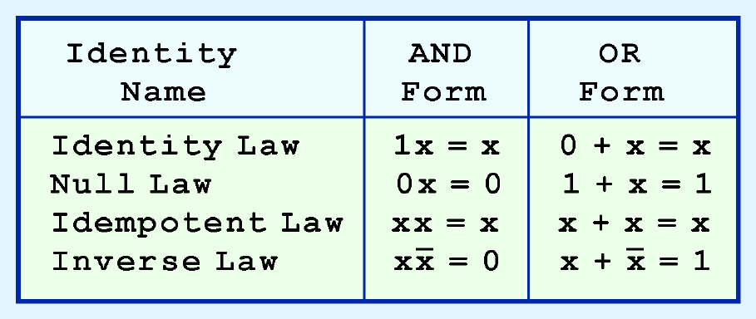
Properties of Boolean Algebra
▶ Most Boolean identities have an AND (product) form as well as an OR (sum) form.

Slide 114
▶ Our second group of Boolean identities should be familiar to you from your study of algebra:

Slide 115
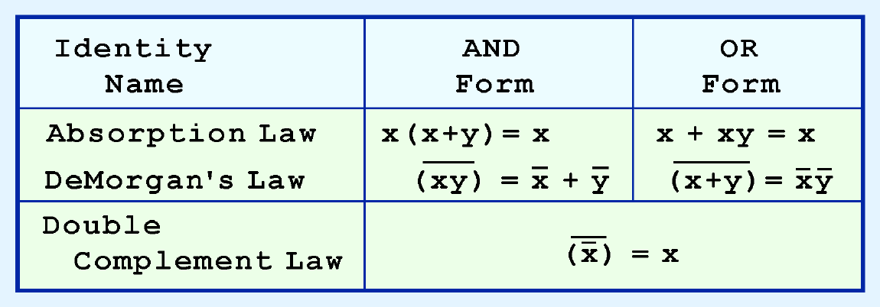
▶ Our last group of Boolean identities are perhaps the most useful.
▶ If you have studied set theory or formal logic, these laws are also familiar to you.

Slide 116
▶ We can use Boolean identities to simplify the function:
as follows:

Slide 117
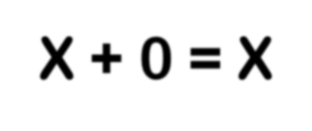
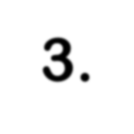
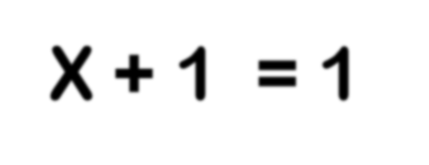
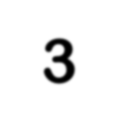
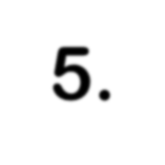
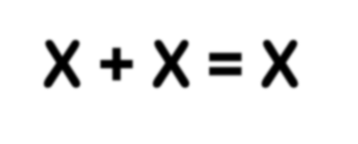
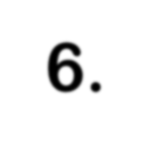
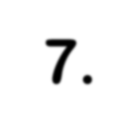
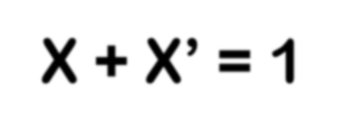
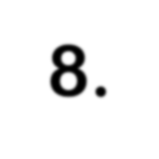
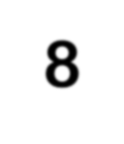
With respect to duality, Identities 1 – 8 have the following relationship:
1. X + 0 = X
3. X + 1 = 1
5. X + X = X
7. X + X’ = 1
2. X • 1 = X
4. X • 0 = 0
6. X • X = X
8. X • X’ = 0
(dual of 1)
(dual of 3)
(dual of 5)
(dual of 8)

Slide 118
Algebraic Manipulation
▶ Boolean algebra is a useful tool for simplifying digital circuits.
▶ Why do it? Simpler can mean cheaper, smaller, faster.
▶ Example: Simplify F = x’yz + x’yz’ + xz.
F= x’yz + x’yz’ + xz
= x’y(z+z’) + xz
= x’y•1 + xz
= x’y + xz
▶ Example: Prove x’y’z’ + x’yz’ + xyz’ = x’z’ + yz’
▶ Proof: x’y’z’+ x’yz’+ xyz’
= x’y’z’ + x’yz’ + x’yz’ + xyz’
= x’z’(y’+y) + yz’(x’+x)
= x’z’•1 + yz’•1
= x’z’ + yz’

Slide 119
Complementation
▶ Sometimes it is more economical to build a circuit using the complement of a function (and complementing its result) than it is to implement the function directly.
▶ DeMorgan’s law provides an easy way of finding the complement of a Boolean function.
▶ DeMorgan’s law states:

Slide 120
▶ Find the complement of F(x, y, z) = x y’ z’ + x’ y z
▶ G = F’ = (xy’z’ + x’yz)’
= (xy’z’)’ • (x’yz)’ DeMorgan
= (x’+y+z) • (x+y’+z’) DeMorgan again
▶ Note: The complement of a function can also be derived by finding the
function’s dual, and then complementing all of the literals

Slide 121
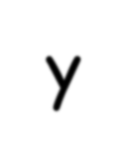
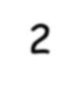
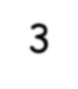
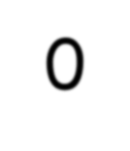
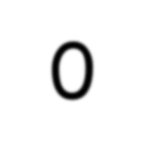
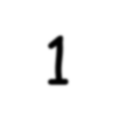
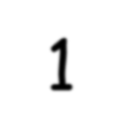
Truth Table
x | y | z |  | F₁ | F₂ | F₃
0 | 0 | 0 |  | 0 | 1 | 1
0 | 0 | 1 |  | 0 | 0 | 1
0 | 1 | 0 |  | 0 | 0 | 1
0 | 1 | 1 |  | 0 | 1 | 1
1 | 0 | 0 |  | 0 | 1 | 0
1 | 0 | 1 |  | 0 | 1 | 0
1 | 1 | 0 |  | 0 | 0 | 0
1 | 1 | 1 |  | 1 | 0 | 1
▶ Enumerates all possible combinations of variable values and the corresponding function value
▶ Truth tables for some arbitrary functions
F₁(x,y,z), F₂(x,y,z), and F₃(x,y,z) are shown to the right.
▶ Truth table: a unique representation of a Boolean function
▶ If two functions have identical truth tables, the functions
are equivalent (and vice-versa).
▶ Truth tables can be used to prove equality theorems.
▶ However, the size of a truth table grows exponentially with the number of variables involved. This motivates the use of Boolean Algebra.

Slide 122
Standard SOP and POS

Slide 123
Overview
▶ Introduction
▶ SOP and POS
▶ Minterms and Maxterms
▶ Canonical Forms
▶ Conversion Between Canonical Forms
▶ Standard Forms

Slide 124
Introduction
▶ Through our exercises in simplifying Boolean expressions, we see that there are numerous ways of stating the same Boolean expression.
▶These “synonymous” forms are logically equivalent.
▶Logically equivalent expressions have identical truth tables.
▶ In order to eliminate as much confusion as possible, designers express Boolean functions in standardized or canonical form.

Slide 125
SOP and POS
▶ There are two canonical forms for Boolean expressions: Sum-Of-Products (SOP) and Product-Of-Sums (POS).
▶ Recall the Boolean product is the AND operation and the Boolean sum is the OR operation.
▶ In the Sum-Of-Products form, ANDed variables are ORed together.
▶ For example:
▶ In the Product-Of-Sums form, ORed variables are ANDed together:
▶ For example:

Slide 126
Definitions
▶ Literal: A variable or its complement
▶ Product term: literals connected by •
▶ Sum term: literals connected by +
▶ Minterm: a product term in which all the variables appear exactly once, either complemented or un-complemented
▶ Maxterm: a sum term in which all the variables appear exactly once, either complemented or un-complemented

Slide 127
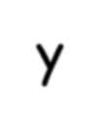
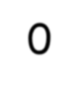
Truth Table notation for Minterms and Maxterms
▶ Minterms and Maxterms are easy to denote
using a truth table.
▶ Example:
Assume 3 variables x,y,z (order is fixed)
▶ Any Boolean function F( ) can be expressed as a unique sum of minterms and a unique product of maxterms (under a fixed variable ordering).
▶ In other words, every function F() has two
canonical forms:
▶ Canonical Sum-Of-Products (sum of minterms)
▶ Canonical Product-Of-Sums (product of maxterms)
x | y | z |  | Minterm | Maxterm
0 | 0 | 0 |  | x’y’z’ = m₀ | x+y+z = M₀
0 | 0 | 1 |  | x’y’z = m₁ | x+y+z’ = M₁
0 | 1 | 0 |  | x’yz’ = m₂ | x+y’+z = M₂
0 | 1 | 1 |  | x’yz = m₃ | x+y’+z’= M₃
1 | 0 | 0 |  | xy’z’ = m₄ | x’+y+z = M₄
1 | 0 | 1 |  | xy’z = m₅ | x’+y+z’ = M₅
1 | 1 | 0 |  | xyz’ = m₆ | x’+y’+z = M₆
1 | 1 | 1 |  | xyz = m₇ | x’+y’+z’ = M₇

Slide 128
Canonical Forms
▶ Canonical Sum-Of-Products:
The minterms included are those m_{j} such that F( ) = 1 in row j of the truth table for F( ).
▶ Canonical Product-Of-Sums:
The maxterms included are those M_{j} such that F( ) = 0 in row j of the truth table for F( ).
f₁(a,b,c) = ∑ m(1,2,4,6), where ∑ indicates that this is a sum-of-products form, and m(1,2,4,6) indicates that the minterms to be included are m₁, m₂, m₄, and m₆.
f₁(a,b,c) = ∏ M(0,3,5,7), where ∏ indicates that this is a product-of-sums form, and M(0,3,5,7) indicates that the maxterms to be included are M₀, M₃, M₅, and M₇.
Since m_{j} = M_{j}’ for any j,
∑ m(1,2,4,6) = ∏ M(0,3,5,7) = f₁(a,b,c)

Slide 129
Conversion Between Canonical Forms
▶ Replace ∑ with ∏ (or vice versa) and replace those j’s that appeared in
the original form with those that do not.
▶ Example:
f₁(a,b,c) = a’b’c + a’bc’ + ab’c’ + abc’
= m₁ + m₂ + m₄ + m₆
= ∑(1,2,4,6)
= ∏(0,3,5,7)
= (a+b+c)•(a+b’+c’)•(a’+b+c’)•(a’+b’+c’)

Slide 130
F = XYZ + XYZ + XYZ + XYZ = m₀ + m₂ + m₅ + m₇ = ∑m(0, 2, 5, 7)
F = XYZ + XYZ + XYZ + XYZ = m₁ + m₃ + m₄ + m₆ = ∑m(1, 3, 4, 6)
F = m₁ + m₃ + m₄ + m₆
⇒ F = m₁ + m₃ + m₄ + m₆ = m₁ ⋅ m₃ ⋅ m₄ ⋅ m₆
→
⇒ F = M₁ ⋅ M ₃ ⋅ M ₄ ⋅ M ₆ = ( X + Y + Z )( X + Y + Z )( X + Y + Z )( X + Y + Z )
= ∏M (1, 3, 4, 6)

Slide 131
Standard Forms
Standard forms are “like” canonical forms, except that not all variables need appear in the individual product (SOP) or sum (POS) terms.
Example:
f₁(a,b,c) = a’b’c + bc’ + ac’
is a standard sum-of-products form
f₁(a,b,c) = (a+b+c)•(b’+c’)•(a’+c’) is a standard product-of-sums form.

Slide 132
Conversion of SOP from standard to canonical form
▶ Expand non-canonical terms by inserting equivalent of 1 in each missing variable x:
(x + x’) = 1
▶ Remove duplicate minterms
▶ f₁(a,b,c) = a’b’c + bc’ + ac’
= a’b’c + (a+a’)bc’ + a(b+b’)c’
= a’b’c + abc’ + a’bc’ + abc’ + ab’c’
= a’b’c + abc’ + a’bc’ + ab’c’

Slide 133
Conversion of POS from standard to canonical form
▶ Expand non-canonical terms by adding 0 in terms of missing variables (e.g., xx’ = 0) and using the distributive law
▶ Remove duplicate maxterms
▶ f₁(a,b,c) = (a+b+c)•(b’+c’)•(a’+c’)
= (a+b+c)•(aa’+b’+c’)•(a’+bb’+c’)
= (a+b+c)•(a+b’+c’)•(a’+b’+c’)•(a’+b+c’)•(a’+b’+c’)
= (a+b+c)•(a+b’+c’)•(a’+b’+c’)•(a’+b+c’)

Slide 134
Minimization Techniques

Slide 135
Overview
▶ Introduction
▶ Karnaugh Map (K-Map)
▶ Simplification Rules
▶ K-Map Simplification for Two Variables
▶ K-Map Simplification for Three Variables
▶ K-Map Simplification for Four Variables
▶ Don’t Care Conditions
▶ Redundancy
▶ Design of Combinational Circuits

Slide 136
Introduction
Truth Table
Unique
Boolean Function
Many different expressions exist
Simplification from Boolean function
Finding an equivalent expression that is least expensive to implement
For a simple function, it is possible to obtain a simple expression for low cost implementation
But, with complex functions, it is a very difficult for implementation

Slide 137
Karnaugh Map (K-map) is a simple procedure for simplification of
Boolean expressions.
Truth Table
Simplified Boolean Function
Karnaugh Map
Boolean function

Slide 138
Karnaugh Map (K-Map)
▶ Karnaugh maps (K-maps) are graphical
representations of Boolean functions.
▶ One map cell corresponds to a row in the truth table.
▶ Also, one map cell corresponds to a minterm or a maxterm in the Boolean expression
▶ Each term is identified by a decimal number whose binary representation is identical to the binary interpretation of the input values of the term.
C’D’
C’D CD CD’
A’B’
A’B
AB
AB’

Slide 139
K-Map Simplification for Two Variables
▶ Of course, the Minterm function that we derived from our Truth Table was not in simplest terms.
▶ That’s what we started with in this example.
▶ We can, however, reduce our complicated expression to its simplest terms by finding adjacent 1s in the K-map that can be collected into groups that are powers of two.
In our example, we have two such groups.
– Can you find them?

Slide 140
K-Map Rules
The rules of K-map simplification are:
Groupings can contain only 1s; no 0s.
The number of 1s in a group must be a power of 2 – even if it contains a single 1.
Nearby 1s are to be grouped.
Corner 1s are to be grouped.
Group that wraps around the sides of a K-map.
Diagonal groups are not allowed.
The groups must be made as large as possible.
Groups can overlap.

Slide 141
K-Map Rules
▶ The best way of selecting two groups of 1s form our simple K- map is shown.
▶ We see that both groups are powers of two and that the groups overlap.

Slide 142
K-Map Simplification for Two Variables
2-variable Karnaugh maps are trivial but can be used to introduce the methods you need to learn. The map for a 2-input OR gate looks like this:
A
A
0 1
Y
B
B
1
0
A
A | B | Y
0 | 0 | 0
0 | 1 | 1
1 | 0 | 1
1 | 1 | 1
1
1
1
B
A+B

Slide 143
K-Map Simplification for Three Variables
▶ A K-map for three variables is constructed as shown in the diagram below.
▶ We have placed each Minterm in the cell that will hold its value.
▶ Notice that the values for the yz combination at the top of the matrix form a pattern that is not a normal binary sequence.

Slide 144
▶ Consider the function:
F (X, Y, Z) = X’Y’Z + X’YZ + XY’Z + XYZ
▶ Its K-map is given below.
▶ What is the largest group of 1s that is a power of 2?

Slide 145
▶ This grouping tells us that changes in the variables x and y have no influence upon the value of the function: They are irrelevant.
▶ This means that the function, F (X, Y, Z) = X’Y’Z + X’YZ + XY’Z + XYZ
reduces to F = Z.
You could verify this reduction with Boolean Algebra

Slide 146
▶ Now for a more complicated K-map. Consider the function:
▶ Its K-map is shown below. There are (only) two groupings of 1s.
▶ Can you find them?

Slide 147
▶ In this K-map, we see an example of a group that wraps around the sides of a K-map.

Slide 148
f = ∑ (0,4) = B C
f = ∑ (4,5) = A B
f = ∑ (0,1,4,5) = B
f = ∑ (0,1,2,3) = A
BC
BC
BC
BC
A
00 01 11 10
A
00 01 11 10
A
00 01 11 10
A
00 01 11 10
0
1
1 | 0 | 0 | 0
1 | 0 | 0 | 0
0
1
0 | 0 | 0 | 0
1 | 1 | 0 | 0
0
1
1 | 1 | 0 | 0
1 | 1 | 0 | 0
0
1
1 | 1 | 1 | 1
0 | 0 | 0 | 0
f = ∑ (1,3) = A’C
f = ∑ (0,4) = A C
f = ∑ (4,6) = A C
f = ∑ (0,2) = A C
f = ∑ (0,2,4,6) = C
BC
BC
BC
BC
A
00 01 11 10
A
00 01 11 10
A
00 01 11 10
A
00 01 11 10
0 0 1 1 0
1 0 0 0 0
0 0 0 0 0
1 1 0 0 1
0 1 0 0 1
1 0 0 0 0
0 1 0 0 1
1 1 0 0 1

Slide 149
K-Map Simplification for Four Variables
▶ The K-map can be extended to accommodate the 16 Minterms that are produced by a four-input function.
▶ This is the format for a 16-minterm K-map.

Slide 150
▶ We have populated the K-map shown below with the nonzero minterms from the function:
▶ Can you identify (only) three groups in this K-map?

Slide 151
▶ Our three groups consist of:
▶ A purple group entirely within the K-map at the right.
▶ A pink group that wraps the top and bottom.
▶ A green group that spans the corners.
▶ Thus we have three terms in our final function:

Slide 152
▶ It is possible to have a choice as to how to pick groups within a K-map, while keeping the groups as large as possible.
▶ The (different) functions that result from the groupings below are logically equivalent.

Slide 153
CD
CD
CD
CD
AB
00
01
11
10
00 01 11 10
00 01 11 10
00 01 11 10
00 01 11 10
AB
00 0 0 0 0
01 0 1 0 0
11 0 1 0 0
10 0 0 0 0
AB
00 0 0 0 0
01 0 0 0 0
11 0 1 1 0
10 0 0 0 0
AB
00
01
11
10
1 | 0 | 0 | 0
0 | 0 | 0 | 0
0 | 0 | 0 | 0
1 | 0 | 0 | 0
0 | 0 | 0 | 0
1 | 0 | 0 | 1
0 | 0 | 0 | 0
0 | 0 | 0 | 0
f = ∑(0,8) = B • C • D
f = ∑ (5,13) = B • C • D
f = ∑ (13,15) = A • B • D
f = ∑ (4,6) = A • B • D
CD
CD
CD
CD
00 01 11 10
00 01 11 10
00 01 11 10
00 01 11 10
AB
00 0 0 1 1
01 0 0 1 1
11 0 0 0 0
10 0 0 0 0
AB
00
01
11
10
AB
00
01
11
10
AB
00
01
11
10
0 | 0 | 0 | 0
1 | 0 | 0 | 1
1 | 0 | 0 | 1
0 | 0 | 0 | 0
0 | 0 | 1 | 1
0 | 0 | 0 | 0
0 | 0 | 0 | 0
0 | 0 | 1 | 1
1 | 0 | 0 | 1
0 | 0 | 0 | 0
0 | 0 | 0 | 0
1 | 0 | 0 | 1
f = ∑ (2,3,6,7) = A • C
f = ∑ (4,6,12,14) = B • D
f = ∑ (2,3,10,11) = B • C
f = ∑ (0,2,8,10) = B • D

Slide 154
CD
CD
CD
CD
00 01 11 10
00 01 11 10
00 01 11 10
00 01 11 10
AB
00 0 0 0 0
01 1 1 1 1
11 0 0 0 0
10 0 0 0 0
AB
00 0 0 1 0
01 0 0 1 0
11 0 0 1 0
10 0 0 1 0
AB
00
01
11
10
AB
00
01
11
10
1 | 0 | 1 | 0
0 | 1 | 0 | 1
1 | 0 | 1 | 0
0 | 1 | 0 | 1
0 | 1 | 0 | 1
1 | 0 | 1 | 0
0 | 1 | 0 | 1
1 | 0 | 1 | 0
f = ∑ (0, 3, 5, 6, 9,10,12,15)
f = A ⊗ B ⊗ C ⊗ D
f = ∑ (1, 2, 4, 7, 8,11,13,14)
f = A ⊕ B ⊕ C ⊕ D
f = ∑ (4, 5, 6, 7) = A • B
f = ∑(3, 7,11,15) = C• D
CD
CD
CD
CD
00 01 11 10
00 01 11 10
00 01 11 10
00 01 11 10
AB
00 0 1 1 0
01 0 1 1 0
11 0 1 1 0
10 0 1 1 0
AB
00
01
11
10
AB
00 0 0 0 0
01 1 1 1 1
11 1 1 1 1
10 0 0 0 0
AB
00
01
11
10
1 | 0 | 0 | 1
1 | 0 | 0 | 1
1 | 0 | 0 | 1
1 | 0 | 0 | 1
1 | 1 | 1 | 1
0 | 0 | 0 | 0
0 | 0 | 0 | 0
1 | 1 | 1 | 1
f = ∑(1, 3,5, 7, 9,11,13,15)
f = D
f = ∑ (0,2,4,6,8,10,12,14)
f = D
f = ∑ (4,5,6,7,12,13,14,15)
f = B
f = ∑ (0,1,2,3,8,9,10,11)
f = B

Slide 155
Don’t Care Conditions
▶ Real circuits don’t always need to have an output defined for every possible
input.
▶ For example, some calculator displays consist of 7-segment LEDs. These LEDs can display 2 ⁷ patterns but all patterns are not used.
▶ If a circuit is designed so that a particular set of inputs can never happen, we call this set of inputs a don’t care condition.
▶ They are very helpful to us in K-map circuit simplification.

Slide 156
▶ In a K-map, a don’t care condition is identified by an X in the cell of the minterm(s) for the don’t care inputs, as shown below.
▶ In performing the simplification, we are free to include or ignore the X’s
when creating our groups.

Slide 157
▶ In one grouping in the K-map below, we have the function:
▶ F = W’X’ + YZ

Slide 158
▶ A different grouping gives us the function:

Slide 159
▶ The truth table of:
F (W, X, Y, Z) = W’X’ + YZ
differs from the truth table of:
▶ However, the values for which they differ, are the inputs for which we have
don’t care conditions.

Slide 160
Redundancy

Slide 161
Design of combinational digital circuits
▶ Steps to design a combinational digital circuit:
▶ From the problem statement derive the truth table
▶ From the truth table derive the unsimplified logic expression
▶ Simplify the logic expression
▶ From the simplified expression draw the logic circuit
▶ Example: Design a 3-input (A,B,C) digital circuit that will give at its output (X) a logic 1 only if the binary number formed at the input has more ones than zeros.

Slide 162
X = ∑(3, 5, 6, 7)
 |  | Inputs |  | Output
 | A | B | C | X
0 | 0 | 0 | 0 | 0
1 | 0 | 0 | 1 | 0
2 | 0 | 1 | 0 | 0 | A
3 | 0 | 1 | 1 | 1
4 | 1 | 0 | 0 | 0
5 | 1 | 0 | 1 | 1
6 | 1 | 1 | 0 | 1
X
BC
00 01 11 10
0
1
0
0
1
0
0
1
1
1
7 1 1 1
1
X = AC + AB + BC
A
B
C

Slide 163
▶ Example: Design a 4-input (A,B,C,D) digital circuit that will give at its output (X) a
logic 1 only if the binary number formed at the input is between 2 and 9 (including).
Inputs Output
X = ∑(2,3,4,5,6,7,8,9)
 | A | B | C | D | X
0 | 0 | 0 | 0 | 0 | 0
1 | 0 | 0 | 0 | 1 | 0
2 | 0 | 0 | 1 | 0 | 1
3 | 0 | 0 | 1 | 1 | 1
4 | 0 | 1 | 0 | 0 | 1
5 | 0 | 1 | 0 | 1 | 1
6 | 0 | 1 | 1 | 0 | 1
7 | 0 | 1 | 1 | 1 | 1
8 | 1 | 0 | 0 | 0 | 1
9 | 1 | 0 | 0 | 1 | 1
10 | 1 | 0 | 1 | 0 | 0
11 | 1 | 0 | 1 | 1 | 0
12 | 1 | 1 | 0 | 0 | 0
13 | 1 | 1 | 0 | 1 | 0
14 | 1 | 1 | 1 | 0 | 0
15 | 1 | 1 | 1 | 1 | 0
X
CD
00 01 11 10
AB
00 0 0 1 1
01 1
Same
1 1 1
11 0 0 0 0
10 1 1 0 0
X = AC + AB + AB C
A
B
C
D
X

Slide 164
Conclusion
▶ K-maps provide an easy graphical method of simplifying Boolean expressions.
▶ A K-map is a matrix consisting of the outputs of the minterms of a
Boolean function.
▶ In this section, we have discussed 2- 3- and 4-input K-maps. This method can be extended to any number of inputs through the use of multiple tables.

Slide 165
Recapping the rules of K-map simplification:
Groupings can contain only 1s; no 0s.
Groups can be formed only at right angles; diagonal groups are not allowed.
The number of 1s in a group must be a power of 2 – even if it contains a single 1.
The groups must be made as large as possible.
Groups can overlap and wrap around the sides of the K-map.
Use don’t care conditions when you can.
Redundancy must be reduced

Slide 166
Lecture of Module 3
Combinational Circuits

Slide 167
Overview
▶ Introduction
▶ Half Adder
▶ Full Adder
▶ Half Subtractor
▶ Full Subtractor
▶ Ripple/Parallel Adder
▶ Adder-Subtractor
▶ Look-ahead carry Adder

Slide 168
Introduction
The outputs of Combinational Logic Circuits are only determined by the logical function of their current input state(s), logic “0” or(and) logic “1”, at any given instant.
Combinational logic circuits give us many useful devices.
One of the simplest is the half adder, which
finds the sum of two bits.

Slide 169
Half Adder

Slide 171
Full Adder

Slide 174
Full Adder using Half Adders

Slide 175
Half Subtractor

Slide 176
Full Subtractor

Slide 178
Full Subtractor using Half Subtractor

Slide 179
Ripple/ Parallel Adder
▶ Just as we combined half adders to make a full adder, full adders can connected in series.
▶ The carry bit “ripples” from one adder to the next; hence, this configuration is
called a ripple-carry adder.

Slide 180
One’s Complement Circuit
In order to make an adder/subtractor, it is
necessary to use a gate that can
This is controlled by a binary signal: Neg. Let B = 1011.
If Neg = 0, then Y = 1011.
If Neg = 1, then Y = 0100.
either pass the value through or generate its
one’s–complement.
The exclusive OR gate, XOR, is exactly what
we need.

Slide 181
Adder-Subtractor

Slide 182
▶ In any combinational circuit, the signal must propagate through the gates before the correct output is available in the output terminal.
▶ The total propagation time equal to the propagation delay of a typical gate times multiplied with the gate levels in the circuit.
▶ The propagation delay time in a parallel adder is the time it takes the carry to propagate through the full adder.
▶ In each full adder the carry out from the carry in passes through two gate levels.
▶ For n-bit parallel adder the total gate delay will be 2n.

Slide 183
▶ So, the carry propagation time is a limiting factor on the speed with which two numbers are added in parallel.
▶ To avoid that another adder is widely used which employs the principle of Look-ahead carry.
▶ The adder designed using the principle of Look-ahead carry is called as Look-ahead carry adder or Carry look-ahead adder.

Slide 184
Look-Ahead Carry Adder
P_{i} = A_{i} Ꚛ B_{i} G_{i} = A_{i} B_{i}
The output Sum and Carry can be expressed as:
A_{i}
S_{i}
P_{i}
B_{i}
S = P Ꚛ Ci
G_{i}
i i
C_{i+1} = G_{i} + P_{i} C_{i}
^{C}i+1
C_{i}
G_{i} is called as carry generator and P_{i} is called as carry propagator.
These equations show that a carry signal will be generated in two cases:
if both bits A_{i} and B_{i} are 1
if either A_{i} or B_{i} is 1 and the carry-in C_{i} is 1.

Slide 185
Let's apply these equations for a 4-bit adder:
C₁ = G₀ + P₀C₀
C₂ = G₁ + P₁C₁ = G₁ + P₁(G₀ + P₀C₀) = G₁ + P₁G₀ + P₁P₀C₀ C₃ = G₂ + P₂C₂ = G₂ + P₂G₁ + P₂P₁G₀ + P₂P₁P₀C₀
C₄ = G₃ + P₃C₃ = G₃ + P₃G₂ + P₃P₂G₁ + P₃P₂P₁G₀ + P₃P₂P₁P₀C₀
These expressions show that C₂, C₃ and C₄ do not depend on its previous carry-in.
Therefore C₄ does not need to wait for C₃ to propagate.
As soon as C₀ is computed, C₄can reach steady state.
The same is also true for C₂ and C_{3.}
The general expression is
C_{i+1}= G_{i}+ P_{i}G_{i-1} + P_{i}P_{i-1}G_{i-2} + ....... P_{i}P_{i-1}....P₂P₁G₀ + P_{i}P_{i-1} .... P₁P₀C₀.
This is a two level circuit

Slide 186
Carry Look-Ahead Generator
Full Adder with Look-Ahead Carry
Total 4 gate delay: One gate delay for P_{i} and G_{i} generator, two gate delay for Carry
generator and one gate delay for Sum generator.

Slide 187
Advantages:
CLA Adders generate the carry-in for each full adder simultaneously, by
using simplified equations involving P_{i}, G_{i}, and C_{in}.
This system reduces the propagation delay.
This is because the output carry at any stage is dependent only on the first Carry signal given at the input.
It is the fastest adder when compared to other addition mechanisms.
Disadvantages:
The carry look-ahead adder circuit gets more complicated as the number of variables
increase.
The circuit for a carry look-ahead adder is expensive as it involves more hardware.
As the number of variables increases, the circuit implements more hardware.
Thus, when the carry look-ahead adder is implemented as an IC, the area is bound to
increase.

Slide 188
Ripple Carry Adder vs. Carry Look Ahead Adder
Ripple Carry Adder | Carry Look Ahead Adder
The Carry bit passes through a long logic chain through the entire circuit. | The Carry bit enters in the system only at the input.
As the full adder blocks are dependent on their predecessor blocks’ carry value, the entire system works a little slow. | Since the entire system depends on the first carry input, the computations are very quick, making it the fastest adder.
It has a simple repetitive design. | Has a slightly complicated design with many logic gates
The system design is cheap to manufacture. | The manufacturing process is expensive as compared to other systems.
The ripple carry adder chips have a considerable size and area. | The chip area increases, as there are many components in the circuit.

Slide 189
Combinational Circuits

Slide 190
Overview
▶ BCD Adder
▶ BCD Subtractor
▶ Comparator
▶ Error detection and correction codes

Slide 191
BCD
Decimal BCD Digit
0
0000
1
0001
2
0010
3
0011
4 | 0100
5 | 0101
6 | 0110
7 | 0111
8 | 1000
9
1001

Slide 192
BCD Addition Rules

Slide 193
Comparing Binary and BCD Sums

Slide 194
BCD Adder
▶ In the previous table Decimal sum from 0 to 9, the Binary sum same as BCD sum. So, no
conversion is needed.
▶ Apply correction if the Decimal sum is between 10-19.
The correction is needed (Decimal sum 16-19)when the binary sum has an output carry
K = 1
The correction is needed (Decimal sum 10-15)when Z₈ = 1 and either Z₄ = 1 or Z₂ = 1.
▶ So, the condition for a correction and an output carry can be expressed by the Boolean function:
C = K + Z₈Z₄ + Z₈Z₂
▶ When C = 1, it is necessary to add 0110 to the binary sum to get BCD sum and provide an
output carry for the next stage.

Slide 196
Cascading of BCD Adders

Slide 197
BCD Subtraction Rules
Let two BCD numbers are A and B. B to be subtracted from A.
RULES:
Add 9’s Complement of B to A
If result > 9, Correct by adding 0110
If carry is generated at most significant position then the result is positive and the End around carry must be added
If carry is not generated at most significant position then the result is negative and the result is 9’s complement of original result

Slide 198
Example

Slide 199
9’s Complement Circuit
9’complement of 2 is 7
Binary equivalent of 2 is 0010
1’s complement of 0010 is 1101
Then,
1101
+ 1010
= 0111 which is Binary equivalent of 7
If carry discard it.
9’complement of 3 is 6
Binary equivalent of 3 is 0011
1’s complement of 0011 is 1100
Then,
1100
+ 1010
= 0110 which is Binary equivalent of 6
If carry discard it.

Slide 200
BCD Subtractor Circuit
RULES:
Add 9’s Complement of B to A
If result > 9, Correct by adding 0110
If carry is generated at most significant position then the result is positive and the End around carry must be added
If carry is not generated at most significant position then the result is negative and the result is 9’s complement of original result

Slide 201
Comparator
▶ A magnitude digital Comparator is a combinational circuit that compares two digital or binary numbers in order to find out whether one binary number is equal, less than or greater than the other binary number.
▶ We logically design a circuit for which we will have two inputs one for A and other for B and have three output terminals, one for A > B condition, one for A = B condition and one for A < B condition.
▶ A comparator makes use of a cascade connection of identical sub networks similar to the case of the parallel adder.

Slide 202
1-Bit Magnitude Comparator
▶ A comparator used to compare two bits is called a single bit comparator.
▶ It consists of two inputs each for two single bit numbers and three outputs to generate less than, equal to and greater than between two binary numbers.
From the above truth table logical expressions for each output can be expressed as follows:
A>B: AB' A<B: A'B A=B: A'B' + AB

Slide 203
Logic Diagram
From the above expressions we can derive the
following formula:
By using these Boolean expressions, we can implement a logic circuit for this comparator as given below:

Slide 204
2-Bit Magnitude Comparator
A comparator used to compare two binary numbers each of two bits is called a 2-bit Magnitude comparator. It consists of four inputs and three outputs to generate less than, equal to and greater than between two binary numbers.

Slide 205
From the Truth Table K-map for each output can be drawn as follows:
A>B: A1B1’ + A0B1’B0’ + A1A0B0’ A<B: A1’B1 + A0’B1B0 + A1’A0’B0
A=B: A1’A0’B1’B0’ + A1’A0B1’B0 + A1A0B1B0 + A1A0’B1B0’ A1’B1’ (A0’B0’ + A0B0) + A1B1 (A0B0 + A0’B0’)
(A0B0 + A0’B0’) (A1B1 + A1’B1’) (A0 Ex-Nor B0) (A1 Ex-Nor B1)

Slide 206
Logic Diagram
By using these Boolean expressions, we can implement a logic circuit for this comparator as given below:

Slide 207
4-Bit Magnitude Comparator
A comparator used to compare two binary numbers each of four bits is called a 4-bit magnitude comparator.
It consists of eight inputs each for two four bit numbers.
Three outputs to generate less than, equal to and greater than between two binary numbers.
In a 4-bit comparator the condition of A = B can be possible in the following four cases:
A = B is possible only when all the individual bits of one number exactly coincide with
corresponding bits of another number.
If A3 = B3 and A2 = B2 and A1 = B1 and A0 = B0
As the numbers are binary, the digits are either 0 or 1.
The equality relation of each pair of bits can be expressed logically with an equivalence function.
xi = AiBi + Ai’Bi’ i = 0, 1, 2, 3 where xi = 1 if the pair of bits in position i are equal.
So,
(A = B) = x3 . x2 . x1. x0

Slide 208
In a 4-bit comparator the condition of A>B can be possible in the following four cases:
If A3 = 1 and B3 = 0
If A3 = B3, A2 = 1 and B2 = 0
If A3 = B3, A2 = B2, A1 = 1 and B1 = 0
If A3 = B3, A2 = B2, A1 = B1, A0 = 1 and B0 = 0
The sequential comparison can be expressed logically as:
(A>B) = A3B3’ + x3 A2B2’ + x3x2 A1B1’ + x3x2x1 A0B0’
In a 4-bit comparator the condition of A<B can be possible in the following four cases:
If A3 = 0 and B3 = 1
If A3 = B3, A2 = 0 and B2 = 1
If A3 = B3, A2 = B2, A1 = 0 and B1 = 1
If A3 = B3, A2 = B2, A1 = B1, A0 = 0 and B0 =1
The sequential comparison can be expressed logically as:
(A<B) = A3’B3 + x3 A2’B2 + x3x2 A1’B1 + x3x2x1 A0’B0

Slide 209
Logic Diagram
(A = B) = x3 . x2 . x1. x0
(A>B) = A3B3’ + x3 A2B2’ + x3x2 A1B1’ + x3x2x1 A0B0’
(A<B) = A3’B3 + x3 A2’B2 + x3x2 A1’B1 + x3x2x1 A0’B0

Slide 210
Cascading Comparator
A comparator performing the comparison operation to more than four bits by cascading two or more 4-bit comparators is called cascading comparator.
When two comparators are to be cascaded, the outputs of the lower-order comparator are connected to
corresponding inputs of the higher-order comparator.

Slide 211
Applications of Comparators
Comparators are used in central processing units (CPUs) and microcontrollers (MCUs).
These are used in control applications in which the binary numbers representing physical
variables such as temperature, position, etc. are compared with a reference value.
Comparators are also used as process controllers and for Servo motor control.
Used in password verification and biometric applications.

Slide 212
Error Detection and Correction Codes
▶ Bits 0 and 1 corresponding to two different range of analog voltages. During transmission of binary data from one system to the other, the noise may also be added. Due to this, there may be errors in the received data at other system.
▶ That means a bit 0 may change to 1 or a bit 1 may change to 0. We can’t avoid the interference of noise. But, we can get back the original data first by detecting whether any errors present and then correcting those errors.
▶ For this purpose, we can use the following codes.
Error detection codes
Error correction codes

Slide 213
▶ Error detection codes − are used to detect the errors present in the received data. These codes contain some bits, which are included to the original bit stream. These codes detect the error, if it is occurred during transmission of the original data.
Example − Parity code, Hamming code, CRC code etc.
▶ Error correction codes − are used to correct the errors present in the received data so that, we will get the original data. Error correction codes also use the similar strategy of error detection codes.
It also detects the error.
Example − Hamming code, CRC code etc.
▶ Therefore, to detect and correct the errors, additional bits are appended to the data bits at the time of transmission.

Slide 214
Parity Code Method
▶ A parity bit is an extra bit included in binary message to make total number of 1’s either odd or even.
▶ Parity word denotes number of 1’s in a binary string.
▶ There are two parity system-Even Parity and Odd Parity.
▶ In even parity system 1 is appended to binary string if there is an odd number of 1’s in string otherwise 0 is appended to make total even number of 1’s.
▶ In odd parity system, 1 is appended to binary string if there is even a number of 1’s to make an odd
number of 1’s.
▶ The receiver knows that whether sender is an odd parity generator or even parity generator.
▶ Suppose if sender is an odd parity generator then there must be an odd number of 1’s in received binary string.
▶ If an error occurs to a single bit that is either bit is changed to 1 to 0 or 0 to 1, received binary bit will have an even number of 1’s which will indicate an error.

Slide 215
Parity Generator

Slide 216
Parity Generator and Checker

Slide 217
Parity Generator and Checker
Parity Generator
Parity Generator
Parity Checker
Parity Checker
Even Parity Generator and Checker
Odd Parity Generator and Checker

Slide 218
▶ The limitation of this method is that only error in a single bit would be identified.
▶ It does not tell which bit is incorrect .
▶ It also can not correct the incorrect bit.
▶ To overcome this another code called Hamming Code is used to detect an error.
▶ It indicates which bit is in error.
▶ It also correct that error.
▶ Because of this Hamming Code is called as self correcting code.

Slide 219
Hamming Code
▶ It was developed by R.W. Hamming for error correction.
▶ Hamming code is useful for both detection and correction of error present in the received data.
▶ This code uses multiple parity bits and we have to place these parity bits in the positions of powers of 2.
▶ The minimum value of 'k' for which the following relation is correct is nothing but the
required number of parity bits.
2k ≥ n + k + 1 Where, ‘n’ is the number of bits in the binary code, ‘k’ is the number of parity bits
▶ Therefore, the number of bits in the Hamming code is equal to n + k.
▶ Based on requirement, we can use either even parity or odd parity while forming a Hamming code. But, the same parity technique should be used in order to find whether any error present in the received data.

Slide 220
▶ Let us find the Hamming code for 4-bit binary code
▶ We can find the required number of parity bits by using the following mathematical relation.
▶ 2k ≥ n + k +1
▶ Substitute, n = 4 in the above mathematical relation.
▶ ⇒2k ≥ 4 + k + 1 ⇒ 2k ≥ 5 + k
▶ The minimum value of k that satisfied the above relation is 3. Hence, we require 3 parity bits.
▶ Therefore, the number of bits in Hamming code will be 7, since there are 4 bits in binary
code and 3 parity bits.

Slide 221
▶ We have to place the parity bits and bits of binary code in the Hamming code as shown below.
▶ Now the Hamming code word format will be d7 d6 d5 p4 d3 p2 p1, where ‘d’ represents the data
bit and ‘p’ represents the parity bit.
▶ The parity bit p1, p2 and p4 are assigned values by the following three parity relations.
▶ p1 = d7 ⊕ d5 ⊕ d3 p2 = d7 ⊕ d6 ⊕ d3 p4 = d7 ⊕ d6 ⊕ d5
Example: 1
Construct an even parity seven bit Hamming code for a word 1011.
d7 d6 d5 p4 d3 p2 p1
1 0 1 ? 1 ? ?
From first relation to have even parity p1 should be 1. From second relation to have even parity p2 should be 0. From third relation to have even parity p4 should be 0. So, the final Hamming code is 1 0 1 0 1 0 1.

Slide 222
▶ x = d7 ⊕ d5 ⊕ d3 ⊕ p1 y = d7 ⊕ d6 ⊕ d3 ⊕ p2 z = d7 ⊕ d6 ⊕ d5 ⊕ p4
▶ For finding the position of error the following relations are to be followed.
▶ The parity check may be even parity or odd parity
▶ If parity relation is satisfied then x or y or z equal to 0, otherwise 1.
Example: 2
The Hamming code is received 1010001. What was the correct code transmitted.
The code received d7 d6 d5 p4 d3 p2 p1
1 0 1 0 0 0 1
Applying first parity relation x = 1. Applying second parity relation y = 1. Applying third parity relation z = 0.
So, z y x = 011, which is equal to 3, that is, third data bit is erroneous one and should be corrected as
1 instead of 0. Now, the correct code is 1 0 1 0 1 0 1.

Slide 223
Combinational Circuits

Slide 224
Overview
▶ Multiplexer
▶ De-Multiplexer
▶ Decoder
▶ Encoder
▶ Priority Encoder
▶ BCD to Seven Segment Display

Slide 225
Multiplexer
▶ A Multiplexer or Mux is a device that has many inputs and a single output.
▶ It selects a single input to the output from several inputs.
▶ The particular input chosen for output is determined by
the value of the multiplexer’s control lines.
▶ To be able to select among n inputs, log₂n control lines are needed.
▶ A multiplexer is also called as a data selector.
▶ The main purpose of Mux is to perform high speed switching.
▶ In analog applications, these are made up of transistor switches and relays, whereas in digital applications,
Block diagram of Multiplexer
these are made up of logic gates.

Slide 226
4-to-1 multiplexer
▶ This is what a 4-to-1 multiplexer looks like on the inside.
▶ The 4X1 multiplexer comprises 4-input bits, 1- output bit, and 2- control bits.
▶ The control bit AB decides which of the i/p data bit should transmit the output.
▶ For example, when the control bits AB =00, then the higher AND gate are allowed while remaining AND gates are restricted. Thus, data input d0 is transmitted to the output ‘q”

Slide 227
8-to-1 multiplexer
A₀
A₁ A₂ A₃
A₄
I₁
A
5
A₆
A₇
I
0
S₂
S₁
S₀

Slide 228
16-to-1 multiplexer
S₃
S₂ S₁
S₀
I₁
I₀

Slide 229
Applications
▶ A Multiplexer is used in various applications wherein multiple data can be transmitted using a single line.
▶ A Multiplexer is used to increase the efficiency of the communication system by allowing the transmission of data, such as audio & video data from different channels via cables and single lines.
▶ A Multiplexer is used in computer memory to decrease the number of copper lines
necessary to connect the memory to other parts of the computer.
▶ A multiplexer is used in telephone networks to integrate the multiple audio signals on a single line of transmission.
▶ A Multiplexer is used to transmit the data signals from the computer system of a satellite to the ground system by using a GSM (Global System for Mobile communication) communication.

Slide 230
MUX as Universal Logic Circuit

Slide 231
Boolean function implementation using Mux

Slide 232
Rules:
If two min-terms are not circled in a coloumn,
apply 0 to Mux input.
If two min-terms are circled in a coloumn, apply 1 to Mux input.
If bottom one is circled and top one is not circled in a column, apply A to Mux input.
If bottom one is not circled and top one is
circled in a column, apply A’ to Mux input.

Slide 233
Demultiplexer
▶ A Demultiplexer or Demux is a circuit which can distribute or deliver multiple outputs from a single input.
▶ It can perform as single input many output switch.
▶ The output lines of demultiplexer are ‘N’ in number, select line number is ‘M’ and N = 2^{M}.
▶ The control signal or select input code decides the output line to which the input has to be transmitted.
▶ It is also called as Data distributor.
▶ There are several types of Demultiplexers
1:2 Demultiplexer or 1-to-2 Demultiplexer
1:4 Demultiplexer
1:8 Demultiplexer
1:16 Demultiplexer

Slide 234
1:2 Demultiplexer

Slide 235
1:4 Demultiplexer
The input bit is Data D with two select lines A and B.
The input bit D is transmitted to four output bits Y0, Y1, Y2, and Y3.
When AB is 00 the upper AND gate is enabled while the other AND gates are disabled. Thus, the data is transmitted to Y0.
If D is low, then Y0 is low and if D is high, Y0 is high. The value of Y0 depends on the value of D.

Slide 236
1:8 Demultiplexer

Slide 237
Applications of Demultiplexer (Demux)
▶ Demux are widely used in microprocessor, computers and digital electronics.
▶ Demultiplexer and Multiplexer both are used in communication systems to carry multiple data signals (i.e. audio, video etc) using single line for transmission.
▶ In Arithmetic logic unit (ALU), the output of ALU can be stored in storage unit (multiple registers) by using Demultiplexer.
It is also used
▶ To enable the different rows of memory chips depends on the address. Also to chose different banks of memory.
▶ To enable different functional unit in the system
▶ To select different IO devices for data transfer
▶ Data acquisition systems
▶ Automatic test equipment systems
▶ Security monitoring systems

Slide 238
Decoder
▶ Decoder is a combinational logic circuit whose purpose is to decode the information.
▶ It is comprised of n number of input lines and 2^{n} number of output lines.
▶ In every probable input condition, among the various output signals, only one output signal will produce the logic one.
▶ So, this is n-to-2^{n} decoder, where n input lines and 2^{n} output lines.
▶ Generally, there are 3 types of line
decoders (2-to-4, 3-to-8 and 4-to-16).

Slide 240
Logic Design Using Decoders
▶ An 𝑛-to-2^{𝑛} line decoder is a minterm generator.
▶ By using or-gates in conjunction with an 𝑛-to-2^{𝑛} line decoder, realizations of Boolean functions are possible.
▶ Do not correspond to minimal sum-of-products.
▶ Are simple to produce. Particularly convenient when several functions of
the same variable have to be realized.

Slide 242
Implementation of a Full Adder circuit using Decoder.
S(x₀, x₁, x₂) = ∑(1, 2, 4, 7)
C(x₀, x₁, x₂) = ∑(3, 5, 6, 7)
x | y | z | C | S
0 | 0 | 0 | 0 | 0
0 | 0 | 1 | 0 | 1
0 | 1 | 0 | 0 | 1
0 | 1 | 1 | 1 | 0
1 | 0 | 0 | 0 | 1
1 | 0 | 1 | 1 | 0
1 | 1 | 0 | 1 | 0
1 | 1 | 1 | 1 | 1
S
C

Slide 243
Decoders with enable inputs
▶ When disabled, all outputs of the decoder can either be at logic-0 or logic-1.
▶ Enable input provides the decoder with additional flexibility.
▶ Idea: if data is applied to the enable input.
▶ Process is known as demultiplexing.
▶ Now Decoder works as Demultiplexer.
𝑥₀𝑥₁𝐸
If 𝑥₀ = 0, 𝑥₁ = 0 then data appears on line 𝑧₀.
Data
▶ Enable inputs are useful when constructing larger decoders from smaller decoders.

Slide 244
Larger Decoders from smaller Decoder

Slide 245
Applications
▶ In digital electronic decoder play an important role. It is used to convert the data from
one form to another form.
▶ Generally, these are frequently used in the communication systems like telecommunication, networking, and transfer the data from one end to the other end.
▶ In the same way it is also used in the digital domain for easy transmission of data.
▶ It is also used as
Binary to Octal converter BCD to Decimal converter
BCD to Seven Segment Display
▶ Boolean functions can be implemented using decoder.

Slide 246
BCD to Seven segment display
▶ The Seven segment display is most frequently used the digital display in calculators, digital counters, digital clocks, measuring instruments, etc.
▶ Usually, the displays like LED’s as well as LCD’s are used to display the
characters as well as numerical numbers.
▶ These displays are frequently driven by the output phases of digital integrated circuits like decade counters as well as latches.
▶ However, the outputs of these are in the type of 4-bit BCD (Binary Coded Decimal), so not appropriate for directly operating the seven segment display.
▶ For that, a display decoder can be employed for converting BCD code to seven segment code.
▶ Generally, it has four input lines as well as seven output lines.
▶ The Decoder is an essential component in BCD to seven segment display.

Slide 247
▶ The circuit design, as well as operation, mainly depends on the concepts of Boolean Algebra as well as logic gates.
▶ The common terminals are either anode or cathode. So, it may be common cathode type
or common anode type.

Slide 248
Truth Table
a = F1 (A, B, C, D) = ∑m (0, 2, 3, 5, 6, 7, 8, 9)
b = F2 (A, B, C, D) = ∑m (0, 1, 2, 3, 4, 7, 8, 9)
c = F3 (A, B, C, D) = ∑m (0, 1, 3, 4, 5, 6, 7, 8, 9)
d = F4 (A, B, C, D) = ∑m (0, 2, 3, 5, 6, 8, 9)
e = F5 (A, B, C, D) = ∑m (0, 2, 6, 8)
f = F6 (A, B, C, D) = ∑m (0, 4, 5, 6, 8, 9)
g = F7 (A, B, C, D) = ∑m (2, 3, 4, 5, 6, 8, 9)

Slide 249
K-Map

Slide 250
Logic Circuit

Slide 251
IC and Connection Diagram

Slide 252
Encoder
▶ An Encoder is a combinational circuit that performs
the reverse operation of Decoder.
▶ It has maximum of 2^{N} input lines and ‘N’ output lines, hence it encodes the information from 2^{N} inputs into an N-bit code.
▶ It will produce a binary code equivalent to the input.

Slide 253
▶ The 4 to 2 Encoder consists of four inputs Y3, Y2, Y1, Y0 and two outputs A1 and A0.
▶ At any time, only one of these 4 inputs can be ‘1’ in order to get the respective binary code at the output.
▶ The 8 to 3 Encoder or octal to Binary encoder consists of 8 inputs : Y7 to Y0 and 3 outputs : A2, A1 & A0.
▶ Each input line corresponds to each octal digit and three outputs generate corresponding binary code.
4 to 2 Encoder
8 to 3 Encoder

Slide 254
4-to-2 Binary Encoder
w₃ | w₂ | w₁ | w₀ | y₁ | y₀
0 | 0 | 0 | 1 | 0 | 0
0 | 0 | 1 | 0 | 0 | 1
0 | 1 | 0 | 0 | 1 | 0
1 | 0 | 0 | 0 | 1 | 1
w₀
w
1
y₀
w₂
w₃
y₁

Slide 255
8-to-3 Binary Encoder
At any one time, only
one input line has a value of 1.
Inputs
Outputs
^{D}0 D1 |  | D₂ | D₃ | D₄ | D5 | D₆ | D₇ | A | B | C
1 | 0 | 0 | 0 | 0 | 0 | 0 | 0 | 0 | 0 | 0
0 | 1 | 0 | 0 | 0 | 0 | 0 | 0 | 0 | 0 | 1
0 | 0 | 1 | 0 | 0 | 0 | 0 | 0 | 0 | 1 | 0
0 | 0 | 0 | 1 | 0 | 0 | 0 | 0 | 0 | 1 | 1
0 | 0 | 0 | 0 | 1 | 0 | 0 | 0 | 1 | 0 | 0
0 | 0 | 0 | 0 | 0 | 1 | 0 | 0 | 1 | 0 | 1
0 | 0 | 0 | 0 | 0 | 0 | 1 | 0 | 1 | 1 | 0
0 | 0 | 0 | 0 | 0 | 0 | 0 | 1 | 1 | 1 | 1

Slide 256
Priority Encoder
▶ One of the main disadvantages of standard digital encoder is that they can generate the wrong output code when there is more than one input present at logic level “1”.
▶ One simple way to overcome this problem is to “Prioritize” the level of each input pin.
▶ If there is more than one input at logic level “1” at the same time, the actual output code would only correspond to the input with the highest designated priority.
▶ This type of digital encoder is known as Priority Encoder or P-Encoder for short.
▶ The Priority Encoder solves the problems by allocating a priority level to each input.
▶ The priority encoders output corresponds to the currently active input which has the highest priority.
▶ So, when an input with a higher priority is present, all other inputs with a lower priority will
be ignored.

Slide 257
4-to-2 Priority Encoder
Truth Table
x
x
0 0 0 0
0 0 0 1
w₃
w₂ w₁ w₀ y₁ y₀
w₃ w₂ w₁ w₀ y₁ y₀
0 0 1 x
0 0 0 0
0 0 0 1
0 0 1 x
1 x x
x x x
x x
0 0
0 1
1 0
1 1
0 0 0 0
x x
0 0 0 1
0 0
0 1 x x
0 0 1
x
0 1
0 1
x x
1 0
1
x x x
1 1
1 x x x

Slide 258
K-Map
x x
w₁ w₀
00 01 11 10
w₃ w₂
00
01
11
10
x | 0 | 0 | 0
1 | 1 | 1 | 1
1 | 1 | 1 | 1
1 | 1 | 1 | 1
y₁ = w₃ + w₂

Slide 259
x x
w₁ w₀
00 01 11 10
w₃ w₂
x | 0 | 1 | 1
0 | 0 | 0 | 0
1 | 1 | 1 | 1
1 | 1 | 1 | 1
00
01
11
10
y₀ = w₃ + w₁ w₂

Slide 260
Circuit for the 4-to-2 priority encoder
y₀ = w₃ + w₁ w₂
y₁ = w₃ + w₂

Slide 261
8-to-3 Priority Encoder
▶ From the truth table of the Priority Encoder, the Boolean expression with data inputs D₀ to D₇ and outputs Q₀, Q₁, Q₂ is given as:

Slide 262
Applications
▶ Keyboard Encoder
▶ Interrupt Requests
▶ Octal to Binary Encoder
▶ Decimal to Binary Encoder
▶ Decimal to BCD Encoder

Slide 263
Lecture of Module 4
Sequential Circuits (Latch/Flip Flop)

Slide 264
Overview
▶ Introduction
▶ Latch
▶ Flip Flops
▶ Triggering of Flip Flop
▶ SR, D, JK, T Flip Flop
▶ Master Slave Flip Flop
▶ Characteristic Table and Characteristic Equation
▶ Excitation Table

Slide 265
Sequential Logic Circuits
The output state of a “sequential logic circuit” is a function of the following three states, the “present input”, the “past input” and/or the “past output”. Sequential Logic circuits remember these conditions and stay fixed in their current state until the next clock signal changes.
Sequential logic circuits are generally termed as two state or Bistable devices. Outputs set in one of two basic states, a logic level “1” or a logic level “0” and will remain “latched” (hence the name is latch) indefinitely in this current state or condition until some other input trigger pulse or signal is applied which will cause the bistable to change its state once again.

Slide 266
Sequential Logic: Concept
▶ Sequential Logic circuits remember past inputs and past circuit state.
▶ Outputs from the system are “fed back” as new inputs.
▶ The storage elements are circuits that are capable of storing binary information: Memory.
The basic sequential circuit elements can be divided in two categories:
▶ Level-sensitive (Latches)
▶ High-level sensitive
▶ Low-level sensitive
▶ Edge-triggered (Flip-flops)
▶ Rising (positive) edge triggered
▶ Falling (negative) edge triggered
▶ Dual-edge triggered

Slide 267
Clock
Sequential circuits can be Asynchronous or Synchronous.
Asynchronous sequential circuits change their states and output values whenever a change in input values occurs. Circuit output can change at any time (clock less).
Synchronous sequential circuits change their states and output values at fixed points of time.
This type of circuits achieves synchronization by using a timing signal called the clock.
Clock generator: Periodic train of clock pulses

Slide 268
Memory Devices
Latches: A latch is a memory element whose excitation signals control the state of the device. A latch has two stages set and reset. Set stage sets the output to 1. Reset stage set the output to 0.
Latches are also called level triggered flip flops, because the change on the outputs will
follow the changes of the inputs as long as the Enable input is set.
This causes synchronization problems.
Solution: use latches to create flip-flops that can respond (update) only on specific times (instead of any time).
Flip-flops: A flip-flop is a memory device that has clock signals control the state of the device.
Flip Flops are Edge triggered that change there outputs only at the transition of the clock signal.

Slide 269
Latch Vs. Flip Flop

Slide 270
Synchronous Sequential Circuits: Flip flops as state memory
The flip-flops receive their inputs from the combinational circuit and also from a clock signal with pulses that occur at fixed intervals of time, as shown in the timing diagram.

Slide 271
S-R Latch(NOR version)
S=0
S=0
S=1
S=0
S=1
t
t
t
t
t
0
0
1
0
1
1
0
1
0
1
0
1
0
0
1
0
1
Q
Q
Q
Q
Q
0
R=1
R=0
Last State
R=0
R=0
Last State
R=1
Reset
Set
Forbidden
Recall…
SR latch
Time
R S Q Q Comment
S (set)
0
0
0
?
?
Storedªstate unknown
0
1
0
1
1
0
“Set” Q to 1
0
0
1
0
Now Q “remembers” 1
1
0
1 0 0 1 “Reset” Q to 0
X
Q
0 0 0 1 Now Q “remembers” 0
R (reset)
1
1
0 0 Both go low
0
0
? ? Unstable!
271

Slide 272
S-R Latch(NAND version)
S’ R’ Q Q’
0 0
1 1 0 Set
0
1 1
0
S’
Q
1
Q’ 0
1
R’
Characteristic Table
X Y NAND
0 0 1
0 1 1
1 0 1
1 1 0

Slide 273
S-R Latch(NAND version)
S’ R’ Q Q’
0 0
0 1
1 0
1 1
1
S’
Q
1
1 0 Set
1 0 Last State
Q’ 0
1
R’
X Y NAND
Characteristic Table
0 0 1
0 1 1
1 0 1
1 1 0

Slide 274
S-R Latch(NAND version)
S’ R’ Q Q’
0 0
0 1
1 0
1 1
1
S’
Q
0
1 0 Set
1 Reset
0 Last State
Q’ 1
0
R’
X Y NAND
Characteristic Table
0 0 1
0 1 1
1 0 1
1 1 0

Slide 275
S-R Latch Flop(NAND version)
S’ R’ Q Q’
0 0
0 1 1 0 Set
1 0 0 1 Reset
1 1 1 0 Last State
1
S’
Q
0
Q’ 1
1
R’
0 1 Last State
Characteristic Table
X Y NAND
0 0 1
0 1 1
1 0 1
1 1 0

Slide 276
S-R Latch(NAND version)
0
S’
S’ R’ Q Q’
₀ 1 1 Forbidden
0 1
0
1 1
Q
1
1 0 Set
1 Reset
0 Last State
Q’ 1
0
R’
0 1 Last State
X Y NAND
Characteristic Table
0 0 1
0 1 1
1 0 1
1 1 0

Slide 277
S-R Latch(NAND version)

Slide 278
S-R Flip Flop with Clock signal
Latch is sensitive to input changes ONLY when C=1

Slide 279
S-R Flip Flop with Clock signal
Latch is sensitive to input changes ONLY when C=1

Slide 280
Characteristic Equation of S-R Flip Flop

Slide 281
Triggering of Flip Flop

Slide 282
D Flip Flop
▶ One way to eliminate the undesirable indeterminate state in the RS flip flop is to ensure that inputs S and R are never 1 simultaneously.

Slide 283
Characteristic Equation of D Flip Flop
Q (n+1) = D
Characteristic Equation

Slide 284
J-K Flip Flop
▶ In SR Flip Flop S=R=1 should be avoided.
▶ To overcome that JK Flip Flop developed.
▶ Both the S and the R inputs of the previous SR bistable have now been replaced by two inputs called the J and K inputs respectively after its inventor Jack Kilby. Then this may equates to: J = S and K = R.
▶ When J=0, K=0, no change in state.
▶ When J=0, K=1, Q will reset.
▶ When J=1, K=0, Q will set.
▶ When J=1, K=1, Toggle i.e Q’_{n}

Slide 285
▶ When J=1, K=1, Toggle i.e Q’_{n}
▶ For JK flip-flop if J, K and Clock are equal to 1 the state of flip-flop keeps on toggling which leads to uncertainty in determining the output of the flip- flop. This problem is called Race around the condition.
▶ This can be avoided by
Using Edge triggering of JK Flip Flop
Enhancing the propagation delay
Using Master-Slave Flip Flop

Slide 286
Master-Slave Flip Flop
▶ Master-slave flip flop is designed using two separate flip flops. Out of these, one acts as the master and the other as a slave.
▶ The J-K flip flops are presented in a series
connection.
▶ The output of the master J-K flip flop is fed to the input of the slave J-K flip flop.
▶ The output of the slave J-K flip flop is given as a feedback to the input of the master J-K flip flop.
▶ The clock pulse [Clk] is given to the master J-K flip flop and it is sent through a NOT Gate and thus inverted before passing it to the slave J-K flip flop.
▶ It avoids the race around condition of J-K Flip Flop
CLK

Slide 287
Characteristic Equation of J-K Flip Flop
Q(t+1) = JQ’ + K’Q
Characteristic Equation

Slide 288
T Flip Flop
▶ We can construct the "T Flip Flop" by making changes in the "JK Flip Flop".
▶ The "T Flip Flop" has only one input, which is constructed by connecting the input of JK Flip Flop.
▶ This single input is called T.
▶ Sometimes the "T Flip Flop" is referred to as single input "JK Flip Flop".
▶ In T flip flop, "T" defines the term "Toggle"

Slide 289
Characteristic Equation of T Flip Flop
Q(t+1) = TQ’ + T’Q
Characteristic Equation

Slide 290
Excitation Table
▶ The characteristic table is useful for analysis and for defining the operation of flip flop.
▶ It specifies the next state when the inputs and
present state are known.
▶ During design process we usually know the transition from present state to next state.
▶ So, we want to know conditions that will transition.
the
cause
flip flop input
the required
▶ Therefore, we need a table that lists the required inputs for a given change of states.
▶ Such table is called as Excitation Table.
Excitation Table for different Flip Flops

Slide 291
Sequential Circuit Design Example: B’C’ B’C BC BC’ B’C’ B’C BC BC’ _{B’C’ B’C BC BC’}
 | Count Sequences |  |  | Flip Flop Inputs |  |  | ^{A’} 1 A’ 1 1 ^{A’} A 1 _{A} 1 1 A TA = BC TB = C _{TC = 1} A B ¹ C CLK
 | A | B | C | TA | TB | TC
 | 0 | 0 | 0 | 0 | 0 | 1
 | 0 | 0 | 1 | 0 | 1 | 1
 | 0 | 1 | 0 | 0 | 0 | 1
 | 0 | 1 | 1 | 1 | 1 | 1
 | 1 | 0 | 0 | 0 | 0 | 1
 | 1 | 0 | 1 | 0 | 1 | 1
 | 1 | 1 | 0 | 0 | 0 | 1
 | 1 | 1 | 1 | 1 | 1 | 1
1 | 1 | 1 | 1
1 | 1 | 1 | 1
 |  |  | C
A |  | B

Slide 292
Example:
Let the state equations are:
A (t+1) = A’B’CD + A’B’C + ACD + AC’D’
B (t+1) = A’C + CD’ + A’BC’
C (t+1) = B
D (t+1) = D’
The above equation can be rearranged in the form of characteristic equation of J-K flip flop.
Characteristic equation of J-K flip flop is
C (t+1) = B = B(C+C’) = BC’ + BC
So, J = B
K = B’
D (t+1) = D’ = (1) D’ + (0) D
So, J = 1
K = 1
So, finally
Q(t+1) = JQ’ + K’Q
A (t+1) = A’B’CD + A’B’C + ACD + AC’D’
= (B’CD + B’C)A’ + (CD + C’D’)A
So, J = B’CD + B’C = B’C
K = (CD + C’D’)’ = C’D + CD’ B (t+1) = A’C + CD’ + A’BC’
= (A’C + CD’)(B+B’) + A’BC’
= (A’C + CD’)B’ + (A’C + CD’)B + A’BC’
= (A’C + CD’)B’ + (A’C + CD’ + A’C’)B
So, J = A’C + CD’
J A= B’C
JB = A’C + CD’
JC = B J D = 1
KA = C’D + CD’ KB = AC’+ AD KC = B’
KD = 1
K = (A’C + CD’ + A’C’)’ = AC’+AD

Slide 293
Setup time and Hold time
The Clocking event can be either from low to high or from high to low. The input signal around clocking event must remain unchanged in order to have a correct effect on the outcome of the new state.
▶ T_{s}: the minimum time interval preceding the clocking event the input signal must remain available and unchanged.
▶ T_{h}: the minimum time interval after edge of the clocking event, the input signals must remain unchanged

Slide 294
Applications
Flip flops will find their use in many of the fields in digital electronics. Flip flops are the main components of sequential circuits. Particularly, edge triggered flip flops are very resourceful devices that can be used in wide range of applications like storing of binary data and transferring binary data from one location to other etc. Some of the most common applications of flip flops are
▶ Shift Register
▶ Counter
▶ Storage Registers
▶ Memory
▶ Data transfer
▶ Frequency Dividers etc.

Slide 295
Sequential Circuits (Shift Register)

Slide 296
Overview
▶ Register
▶ Shift Register
▶ Types of Shift Register
▶ Bidirectional Shift Register
▶ Universal Shift Register
▶ Typical ICs for Shift register

Slide 297
Register
▶ The filp flops are essential component in clocked sequential circuits.
▶ Circuits that include filp flops are usually classified by the function they perform.
▶ Two such circuits are registers and counters.
▶ An n-bit register consists of a group of n flip flops capable of storing n bits of binary information.
▶ So, Register is a collection of flip flops.
▶ A flip flop is used to store single bit digital data. For storing a large number of bits, the storage capacity is increased by grouping more than one flip flops.
▶ It is used to perform simple data storage, movement, manipulation and processing operations (e.g. load, increment, shift, add, etc.)
▶ The computer processes data by performing operations on registers, e.g. ADD A, B where A and B are the registers.
▶ A register capable of shifting its binary information in one or both direction is called a shift register.
▶ All flip-flops receive common clock pulses, which activate the shift from one stage to the next.

Slide 298
Shift Register
▶ The simplest possible shift register is one that uses only flip-flops, as shown in Fig.
▶ Each clock pulse shifts the contents of the register one bit position to the right.
▶ The serial input determines what goes into the leftmost flip-flop during the shift.
▶ The serial output is taken from the output of the rightmost flip-flop.
▶ Following are the four types of shift registers based on applying inputs and accessing of outputs.
▶ Serial In − Serial Out shift register
▶ Serial In − Parallel Out shift register
▶ Parallel In − Serial Out shift register
▶ Parallel In − Parallel Out shift register

Slide 299
Serial In − Serial Out (SISO) shift register
▶ The shift register, which allows serial input and produces serial output is known as Serial In – Serial
Out (SISO) shift register.
▶ This block diagram consists of three D flip-flops, which are cascaded. That means, output of one D flip-flop is connected as the input of next D flip-flop.
▶ All these flip-flops are synchronous with each other since, the same clock signal is applied to each one.
▶ In this shift register, we can send the bits serially from the input of left most D flip-flop. Hence, this input is also called as serial input.
▶ For every positive edge triggering of clock signal, the data shifts from one stage to the next. So, we can receive the bits serially from the output of right most D flip-flop. Hence, this output is also called as serial output.
1 0 1

Slide 300
Serial In − Parallel Out (SIPO) shift register
▶ The shift register, which allows serial input and produces parallel output is known as Serial In –
Parallel Out (SIPO) shift register.
▶ In this shift register, we can send the bits serially from the input of left most D flip-flop. Hence, this input is also called as serial input.
▶ For every positive edge triggering of clock signal, the data shifts from one stage to the next.
▶ In this case, we can access the outputs of each D flip-flop in parallel. So, we will get parallel outputs from this shift register.
1 0 1

Slide 301
Parallel In − Serial Out (PISO) shift register
▶ In the "Parallel In Serial Out" register, the data is entered in a parallel way, and the outcome
comes serially.
▶ The shift mode and the load mode are the two modes in which the "PISO" circuit works.

Slide 302
Parallel In − Parallel Out (PIPO) shift register
▶ In "Parallel In Parallel Out", the inputs and the outputs come in a parallel way in the register.
▶ The inputs B₀, B₁, B₂, and B₃, are directly passed to the data inputs D₀, D₁, D₂, and D₃ of the
respective flip flop.
▶ The bits of the binary input is loaded to the flip flops when the negative clock edge is applied. The clock pulse is required for loading all the bits. At the output side, the loaded bits appear.
Input

Slide 303
Bidirectional Shift Register
▶ Below is the diagram of 4-bit "bidirectional" shift register where D_{R} is the "serial right shift data input", D_{L} is the "left shift data input", and M is the "mode select input".
(L/R)
M

Slide 304
Universal Shift Register
▶ A shift-right control to enable the shift operation and the serial input and output lines associated with the shift right.
▶ A shift-left control to enable the shift operation and the serial input and output lines associated with the shift left.
▶ A parallel-load control to enable a parallel transfer and the n input lines associated with the parallel transfer.
▶ If the Shift register has the capability of
Serial In − Serial Out
Serial In − Parallel Out Parallel In − Serial Out Parallel In − Parallel Out
and act as Bidirectional shift register is referred as a universal shift register.
▶ Shift registers are often used to interface digital system situated remotely from each other. If the distance is far, it
will be expensive to use n lines to transmit the n bits in parallel.
▶ Transmitter performs a parallel-to-serial conversion of data and the receiver does a serial-to-parallel conversion.

Slide 305
R / L
SH/LOAD

Slide 306
Universal Shift Register using MUX
Serial input for shift-left

Slide 307
Typical ICs for Shift register
▶ Commonly available SISO IC is 74HC595, which is 8-bit.
▶ Commonly available SIPO IC’s include the standard 8-bit 74LS164, 74LS594.
▶ Commonly available PISO IC is 74HC166, which is 8-bit.
▶ Commonly available PIPO IC’s include the standard 8-bit M54HC195, M74HC195.
▶ Today, there are many high speed bi-directional or “universal” type Shift Registers available such as the TTL 74LS194, 74LS195 or the CMOS 4035 which are available as 4-bit multi-function devices that can be used in either serial-to-serial, left shifting, right shifting, serial-to-parallel, parallel-to-serial, or as a parallel-to-parallel multifunction data register, hence their name “Universal”.
▶ The 74HC299 is an 8-bit Universal Shift register.
▶ The 74S299 is an 8-bit Universal Shift and Storage Register.

Slide 308
Lecture of Module 5
Sequential Circuits (Counter)

Slide 309
Overview
▶ Introduction
▶ Synchronous counter
▶ Asynchronous counter
▶ Up counter
▶ Down counter
▶ Decade counter
▶ Ring counter
▶ Johnson counter

Slide 310
Introduction
Counter essentially a register that goes through predetermined sequence of states upon the application of input pulses.
A counter is a device which can count any particular event on the basis of how many times the particular event(s) is occurred.
In a digital logic system or computers, this counter can count and store the number of time any particular event or process have occurred, depending on a clock signal.
Most common type of counter is sequential digital logic circuit with a single clock input and multiple outputs.
The outputs represent binary or binary coded decimal numbers.
Each clock pulse either increase the number or decrease the number.
Modulus of a counter is the total number of states through which a counter can progress.
Two types of counters:
Synchronous (parallel) counters
Asynchronous (ripple) counters

Slide 311
Synchronous Counter
Synchronous counter known as parallel counter.
All flip flops of the counter changes their states at the same time in synchronous with the input clock signal.
All flip-flops of the counter driven by same clock.
Circuit delay is equal to the propagation delay of one flip flop.
Asynchronous Counter
Known as Ripple counter.
Also known as Serial counter.
Output of one flip flop is used as clock input of other flip flop.
Circuit delay is equal to the sum of propagation delay of all flip flops.

Slide 312
Synchronous Counter
Binary Counter
B’C’ B’C BC BC’
B’C’ B’C BC BC’
B’C’ B’C BC BC’
Count Sequences
A B C
0 0 0
0 0 1
Flip Flop Inputs
TA TB TC
0 0 1
0 1 1
A’
1
A’
1 | 1 |  | A’ | 1 | 1 | 1 | 1
1 | 1 |  | A | 1 | 1 | 1 | 1
A
1
A
TA = BC
TB = C
TC = 1
0 | 1 | 0 | 0 | 0 | 1
0 | 1 | 1 | 1 | 1 | 1
1 | 0 | 0 | 0 | 0 | 1
1 | 0 | 1 | 0 | 1 | 1
1 | 1 | 0 | 0 | 0 | 1
A
B
C
A
B
1
C
CLK
1
1
1
1
1
1

Slide 313
Decade or BCD synchronous counter
▶ A 4-bit decade synchronous counter can also be built using synchronous binary counters to produce a count sequence from 0 to 9.
▶ A standard binary counter can be converted to a decade (decimal 10) counter with the aid of some additional logic to implement the desired state sequence.
▶ After reaching the count of “1001”, the counter recycles back to “0000”. We now have a decade or Modulo- 10 counter or MOD-10 counter.

Slide 314
Asynchronous Counter
Binary Ripple Counter
▶ Ripple counter is an Asynchronous counter. It got its name because the clock pulse ripples through the
circuit.
▶ It is an asynchronous counter.
▶ Different flip-flops are used with a different clock pulse.
▶ All the flip-flops are used in toggle mode.
▶ Only one flip-flop is applied with an external clock pulse and another flip-flop clock is obtained from the
output of the previous flip-flop.
▶ The flip-flop applied with external clock pulse act as LSB (Least Significant Bit) in the counting sequence.
▶ A counter may be an up counter that counts upwards or can be a down counter that counts downwards or can do both i.e. count up as well as count downwards depending on the input control.
▶ When counting up, for n-bit counter the count sequence goes from 000, 001, 010, … 110, 111, 000, 001, …
etc.
▶ When counting down the count sequence goes in the opposite manner: 111, 110, … 010, 001, 000, 111, 110,
… etc.

Slide 315
Ripple Counter
Count Up: When counting up, for n-bit counter
the count sequence goes from 000, 001, 010, …
110, 111, 000, 001, … etc.

Slide 316
Ripple Counter
Count Down: When counting down the count sequence goes in the opposite manner: 111, 110, … 010, 001, 000, 111, 110, … etc.
Count Q2 Q1 Q0
States
7 1 1 1
6 1 1 0
Q0
Q1
Q2
5 | 1 | 0 | 1
4 | 1 | 0 | 0
3 | 0 | 1 | 1
2 | 0 | 1 | 0
1 | 0 | 0 | 1
0
0
0
0

Slide 317
Up/Down Counter (Asynchronous)

Slide 318
Decade or BCD asynchronous counter
▶ If we take the modulo-16 asynchronous counter and modify it with additional logic gates it can be made to give a Decade counter output for use in standard decimal counting and arithmetic circuits. Such counters are generally referred to as Decade Counters or BCD Counters.
▶ A decade counter requires resetting to zero after the output count reaches the decimal value of 9, i.e. when DCBA = 1001.
▶ This type of asynchronous counter counts upwards on each input clock signal starting from 0000 until it
reaches an output 1001 (decimal 9).
▶ When it is 1001, both outputs QA and QD are now equal to logic “1”. On the application of the next clock pulse, by connection NAND gate to QA and QD, the output from the NAND gate changes state from logic “1” to a logic “0” level.
▶ The output of NAND gate is connected to CLEAR inputs of flip flpos.
▶ As, the output of the NAND gate is connected to the CLEAR ( CLR ) inputs of all the flip-flops, this signal causes all of the Q outputs to be reset back to binary 0000 after the count 9.
▶ So, the counter restarts again from 0000. We now have a decade or Modulo-10 up-counter.

Slide 320
Up/Down Counter (Synchronous)

Slide 321
Ring Counter
▶ A ring counter is a type of counter composed of flip flops working as shift register, with the output of the last flip-flop fed to the input of the first, making a "circular" or "ring" structure.
▶ There are two types of ring counters:
▶ A straight ring counter, connects the output of the last shift register to the first shift register input and circulates a single one bit around the ring.
▶ A twisted ring counter, also called switch-tail ring counter, Johnson counter connects the complement of the output of the last shift register to the input of the first register and circulates a stream of ones followed by zeros around the ring.
▶ The straight and twisted forms have different properties, and relative advantages and disadvantages.
▶ A binary counter can represent 2^N states, where N is the number of bits (flip flops).
▶ Whereas a straight ring counter can represent only N states.
▶ Johnson counter can represent 2N states.

Slide 322
▶ Johnson counters are sometimes favored, because they offer twice as many count states from the same number of flip flops in the shift registers, and because they are able to self-initialize from the all-zeros state, without requiring the first count bit to be injected externally at start-up.
▶ The Johnson counter generates a code in which adjacent states differ by only one bit (that is, have a Hamming distance of 1), as in a Gray code, which is advantageous in communication system.
▶ When a fully decoded representation of the counter state is needed, as in some sequence controllers, the straight ring counter is preferred.
▶ There are two types of ring counters:
Straight ring counter Twisted ring counter

Slide 323
Straight ring counter |  |  |  |  |  | Johnson counter
 | State | Q0 | Q1 | Q2 | Q3 |  | State | Q0 | Q1 | Q2 | Q3
 | 0 | 1 | 0 | 0 | 0 |  | 0 | 0 | 0 | 0 | 0
 | 1 | 0 | 1 | 0 | 0 |  | 1 | 1 | 0 | 0 | 0
 | 2 | 0 | 0 | 1 | 0 |  | 2 | 1 | 1 | 0 | 0
 | 3 | 0 | 0 | 0 | 1 |  | 3 | 1 | 1 | 1 | 0
 | 0 | 1 | 0 | 0 | 0 |  | 4 | 1 | 1 | 1 | 1
 | 1 | 0 | 1 | 0 | 0 |  | 5 | 0 | 1 | 1 | 1
 | 2 | 0 | 0 | 1 | 0 |  | 6 | 0 | 0 | 1 | 1
 | 3 | 0 | 0 | 0 | 1 |  | 7 | 0 | 0 | 0 | 1
 | 0 | 1 | 0 | 0 | 0 |  | 0 | 0 | 0 | 0 | 0
Ring Counter
Q’
Johnson Counter
Johnson Counter

Slide 324
Ring counter has 4 sequences: 1000, 0100, 0010,
0001.
Johnson ring counter has sequences like “1000”, “1100”, “1110”, “1111”, “0111”, “0011”, “0001”,
“0000”.
Timing Diagram of Ring Counter
Timing Diagram of Johnson Counter

Slide 325
Differences:
SYNCHRONOUS COUNTERS
The propagation delay is very
low.
Its operational frequency is very high.
These are faster than that of
ripple counters.
Large number of logic gates are required to design
High cost.
Synchronous circuits are easy to design.
Standard logic packages available for synchronous.
ASYNCHRONOUS COUNTERS
Propagation delay is higher than that of synchronous counters.
The maximum frequency of operation is very low.
These are slow in operation.
Less number of logic gates required.
Complex to design.
For asynchronous counters, Standard logic packages are not available.
Low cost.

Slide 326
Applications
Some of the counter applications are listed below.
▶ Frequency counters
▶ Digital clocks
▶ With some changes in their design, counters can be used as frequency divider circuits. The frequency divider circuit is that which divides the input frequency exactly by ‘2’.
▶ Counter used as a timer in electronic devices like ovens and washing machines
▶ Alarm Clock, AC Timer, timer in camera to take the picture, flashing light
indicator in automobiles, car parking control etc.
▶ Counting the time allotted for special process or event by the scheduler.
▶ They are also used in machine moving control.

